Slide 1

2015 Planning Awards
San Diego Section

Slide 2
Welcome...
Honorable Councilmembers
Todd Gloria and Marti Emerald
William Anderson, FAICP, Outgoing APA National President
Hing Wong, AICP, APA CA President
Brooke Peterson, AICP, Outgoing APA CA President
Virginia Viado, APA CA VP Marketing & Membership
Betsy McCullough, AICP, CA VP Conferences

Slide 3
THANK YOU SPONSORS
Wine provided by...
Black Project Controls Inc

Slide 4




California Tower Sponsors

Slide 5








Organ Pavilion Sponsors

Slide 6



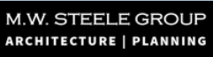



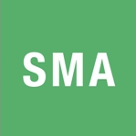

Plaza Sponsors

Slide 7
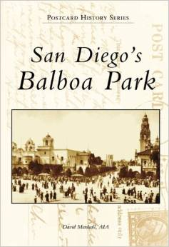
Walking Tour - Thank You
David Marshall, AIA

Slide 8
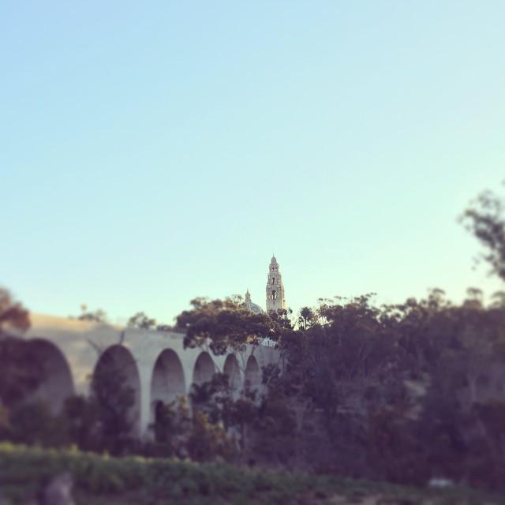
Great Places in
California Award
Balboa Park

Slide 9
Thank You Awards Jury
Chair: Manjeet Ranu, AICP, City of Encinitas
Noah Alvey, AICP, County Planning Mgr.
Vicki Estrada, FASLA, Estrada Land Planning
Jeff Hunt, AICP, Interim City Planner, Oceanside
Sara Osborn, AICP, Sr. Planner, City of San Diego
Emily Young, San Diego Foundation

Slide 10
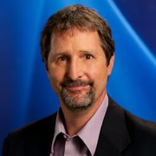
Welcome...
Tom Fudge, KPBS News Editor

Slide 11

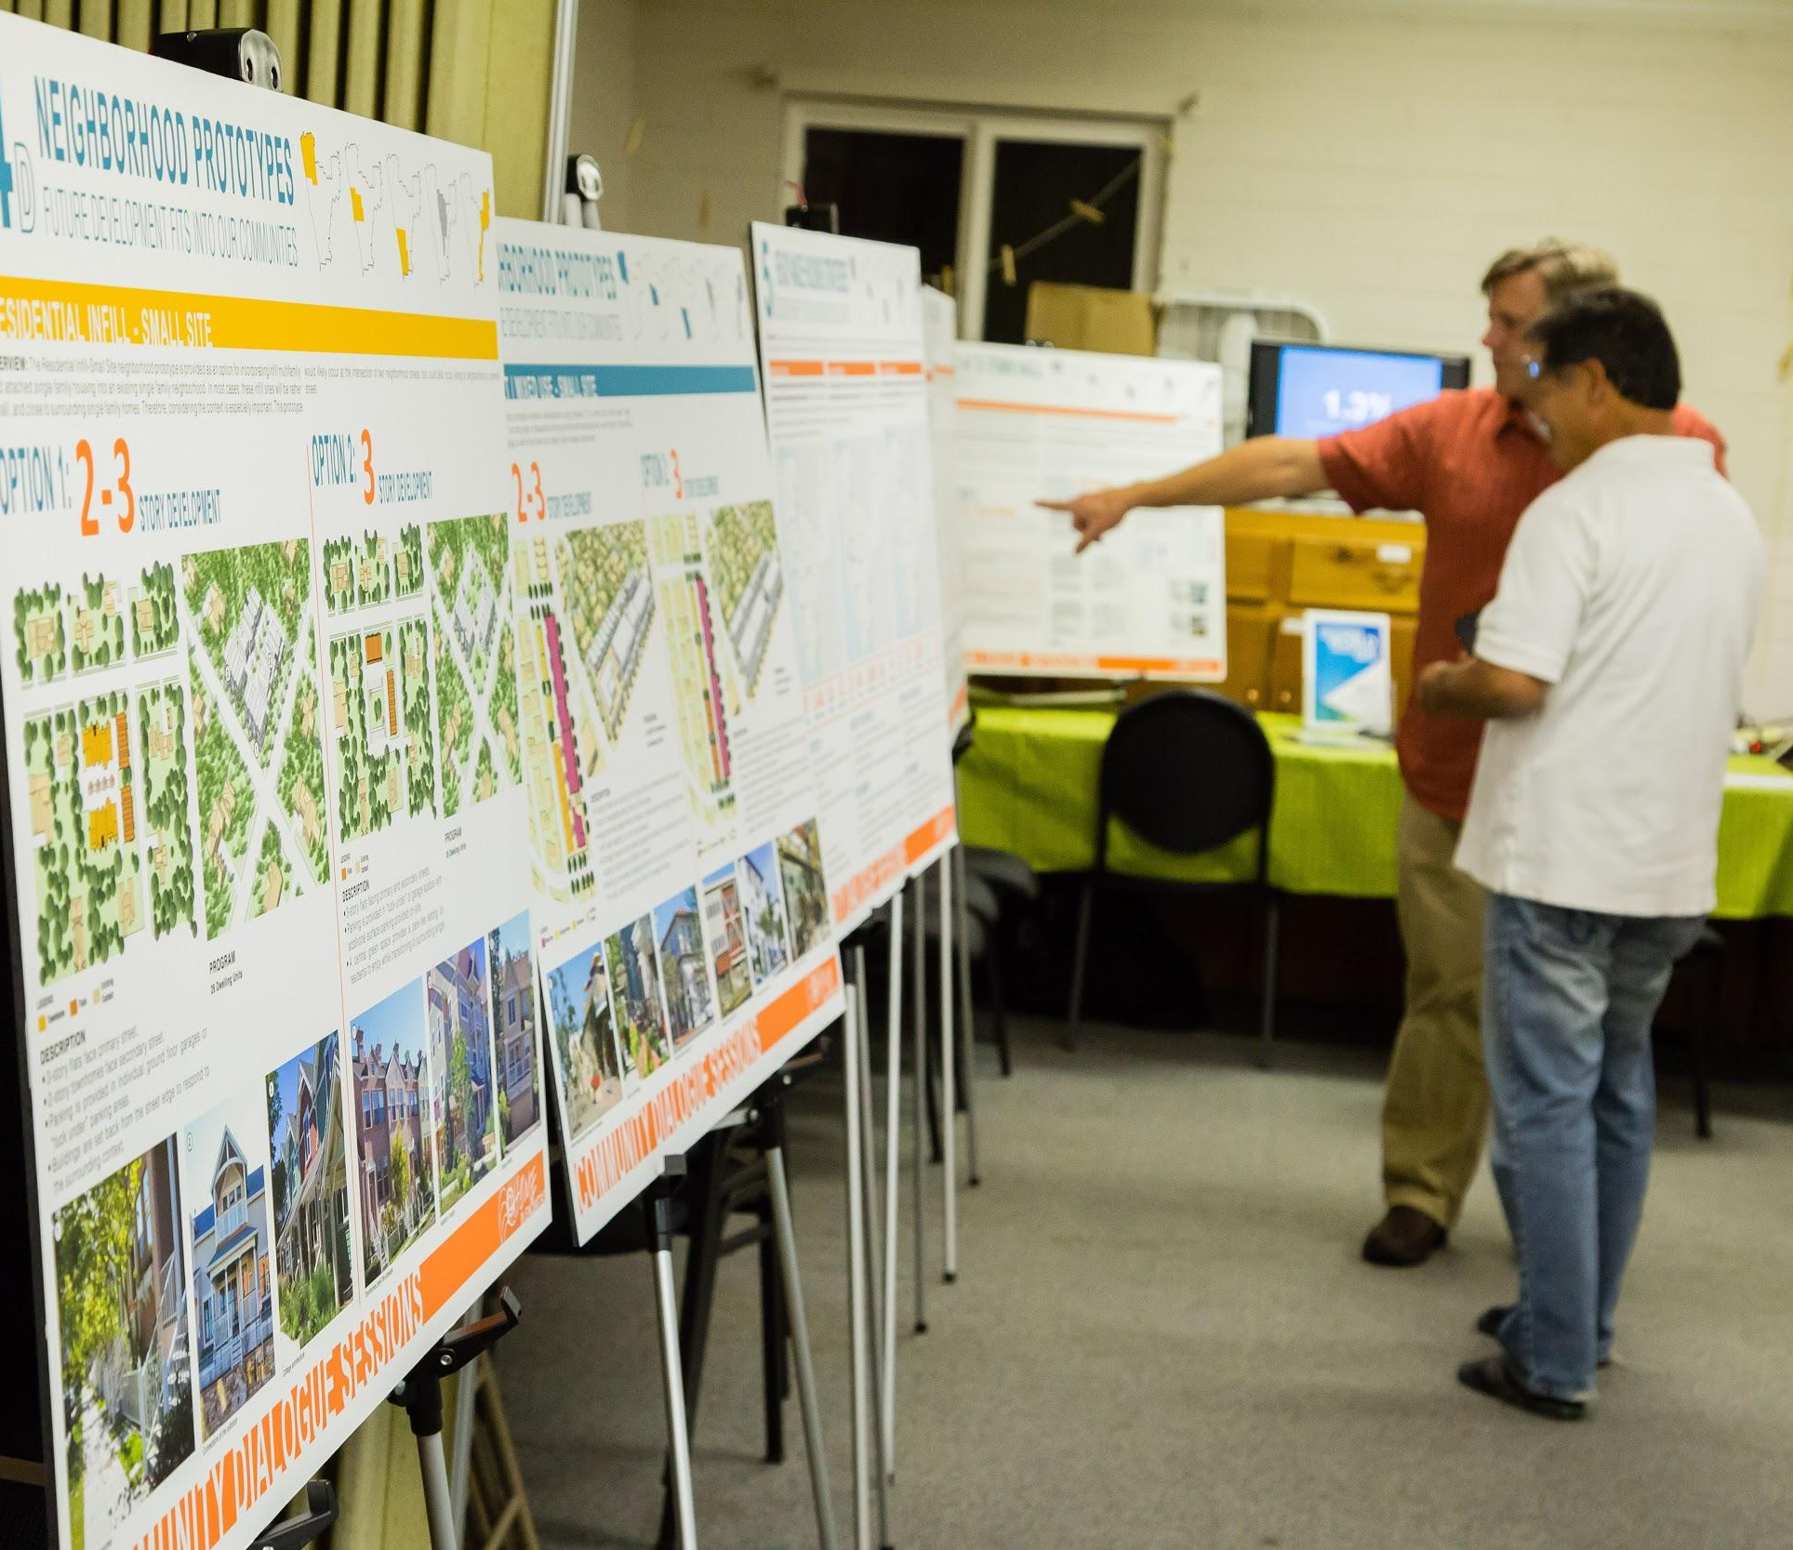
At Home in Encinitas
Public Outreach
Notes:
At Home in Encinitas

Slide 12
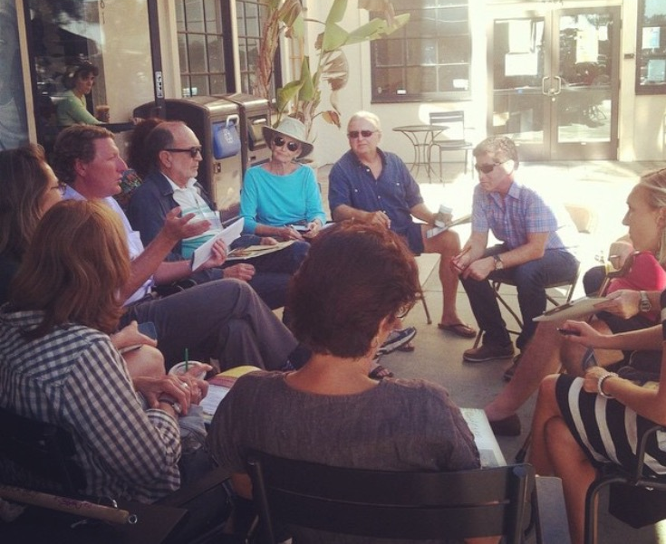
“
The goal [was] to hear from the public early in the process and to use … input to develop an updated Housing Element that includes community-supported solutions. … Visual materials, infographics and provocative plans were used to promote understanding and engagement. Technology was deployed to enable broader participation.”
Notes:
At Home in Encinitas

Slide 13
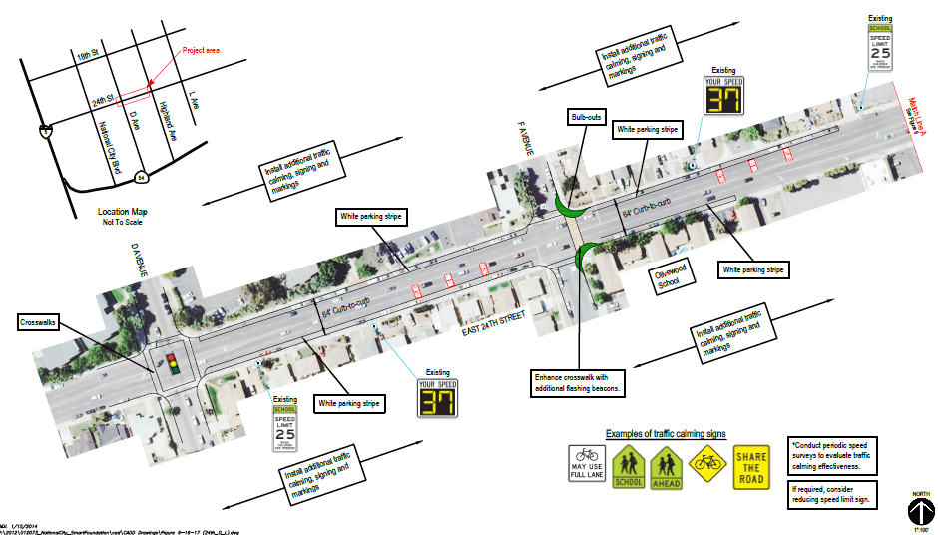
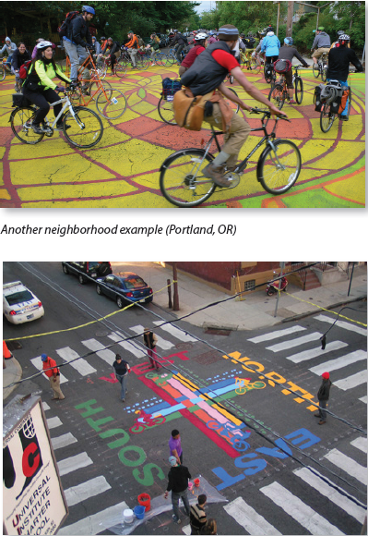
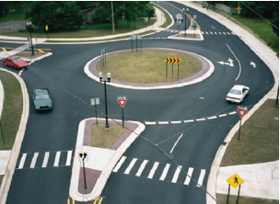
National City SMART Foundation
Comprehensive Planning Award - Small Jurisdiction
Notes:
National City SMART Foundation

Slide 14
“
It is critical that funding be used in areas where it can make the most difference for the health, safety and welfare of the community.”
Notes:
National City SMART Foundation

Slide 15
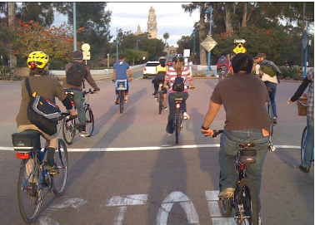
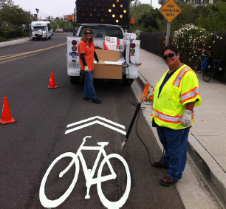
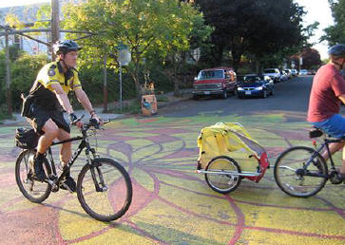
City of San Diego
Bicycle Master Plan Update and EIR
Transportation Planning
Notes:
City of SD Bicycle Master Plan Update

Slide 16
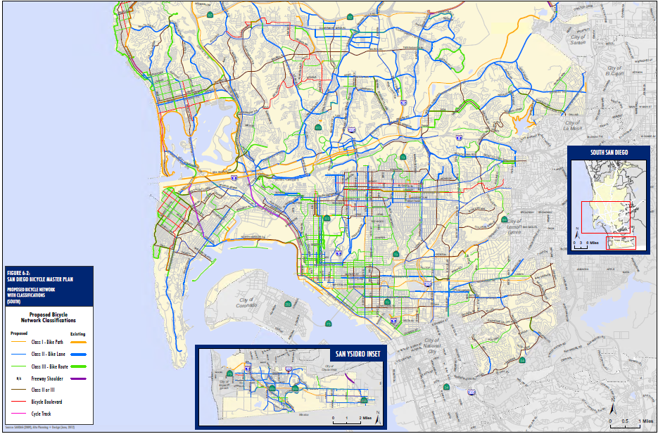
“
Planning a bikeway network enables the City to prioritize and seek funding to construct bicycle facilities where they will provide the greatest benefit to bicyclists and the community-at-
large.”
Notes:
City of SD Bicycle Master Plan Update

Slide 17
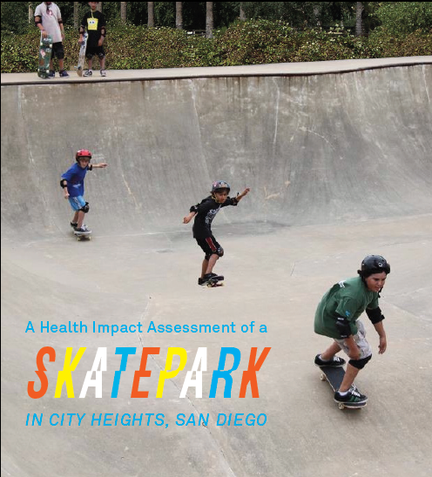
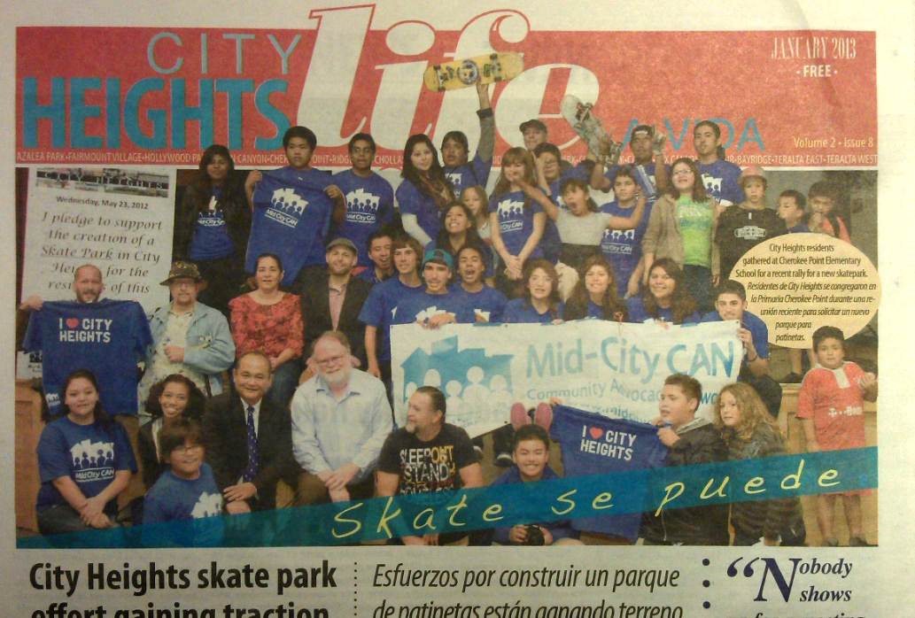
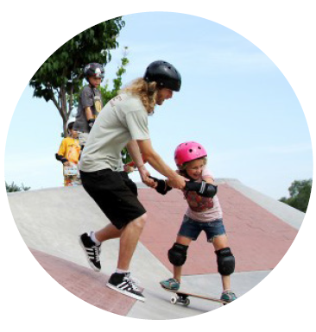
Mid-City CAN Youth Council
Grassroots Initiative
Notes:
Mid-city CAN youth council

Slide 18
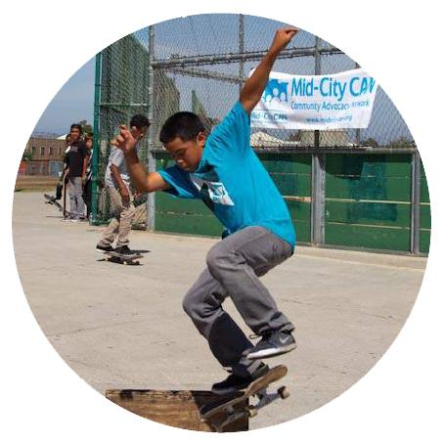
“
[The Mid-City CAN Youth Council’s] multi-year planning process ... has demonstrated that activism can ... be an outlet for young people to express themselves through their community involvement. ... This park will be a public display of youth power for the community of City Heights, San Diego.”
Notes:
Mid-city CAN youth council

Slide 19
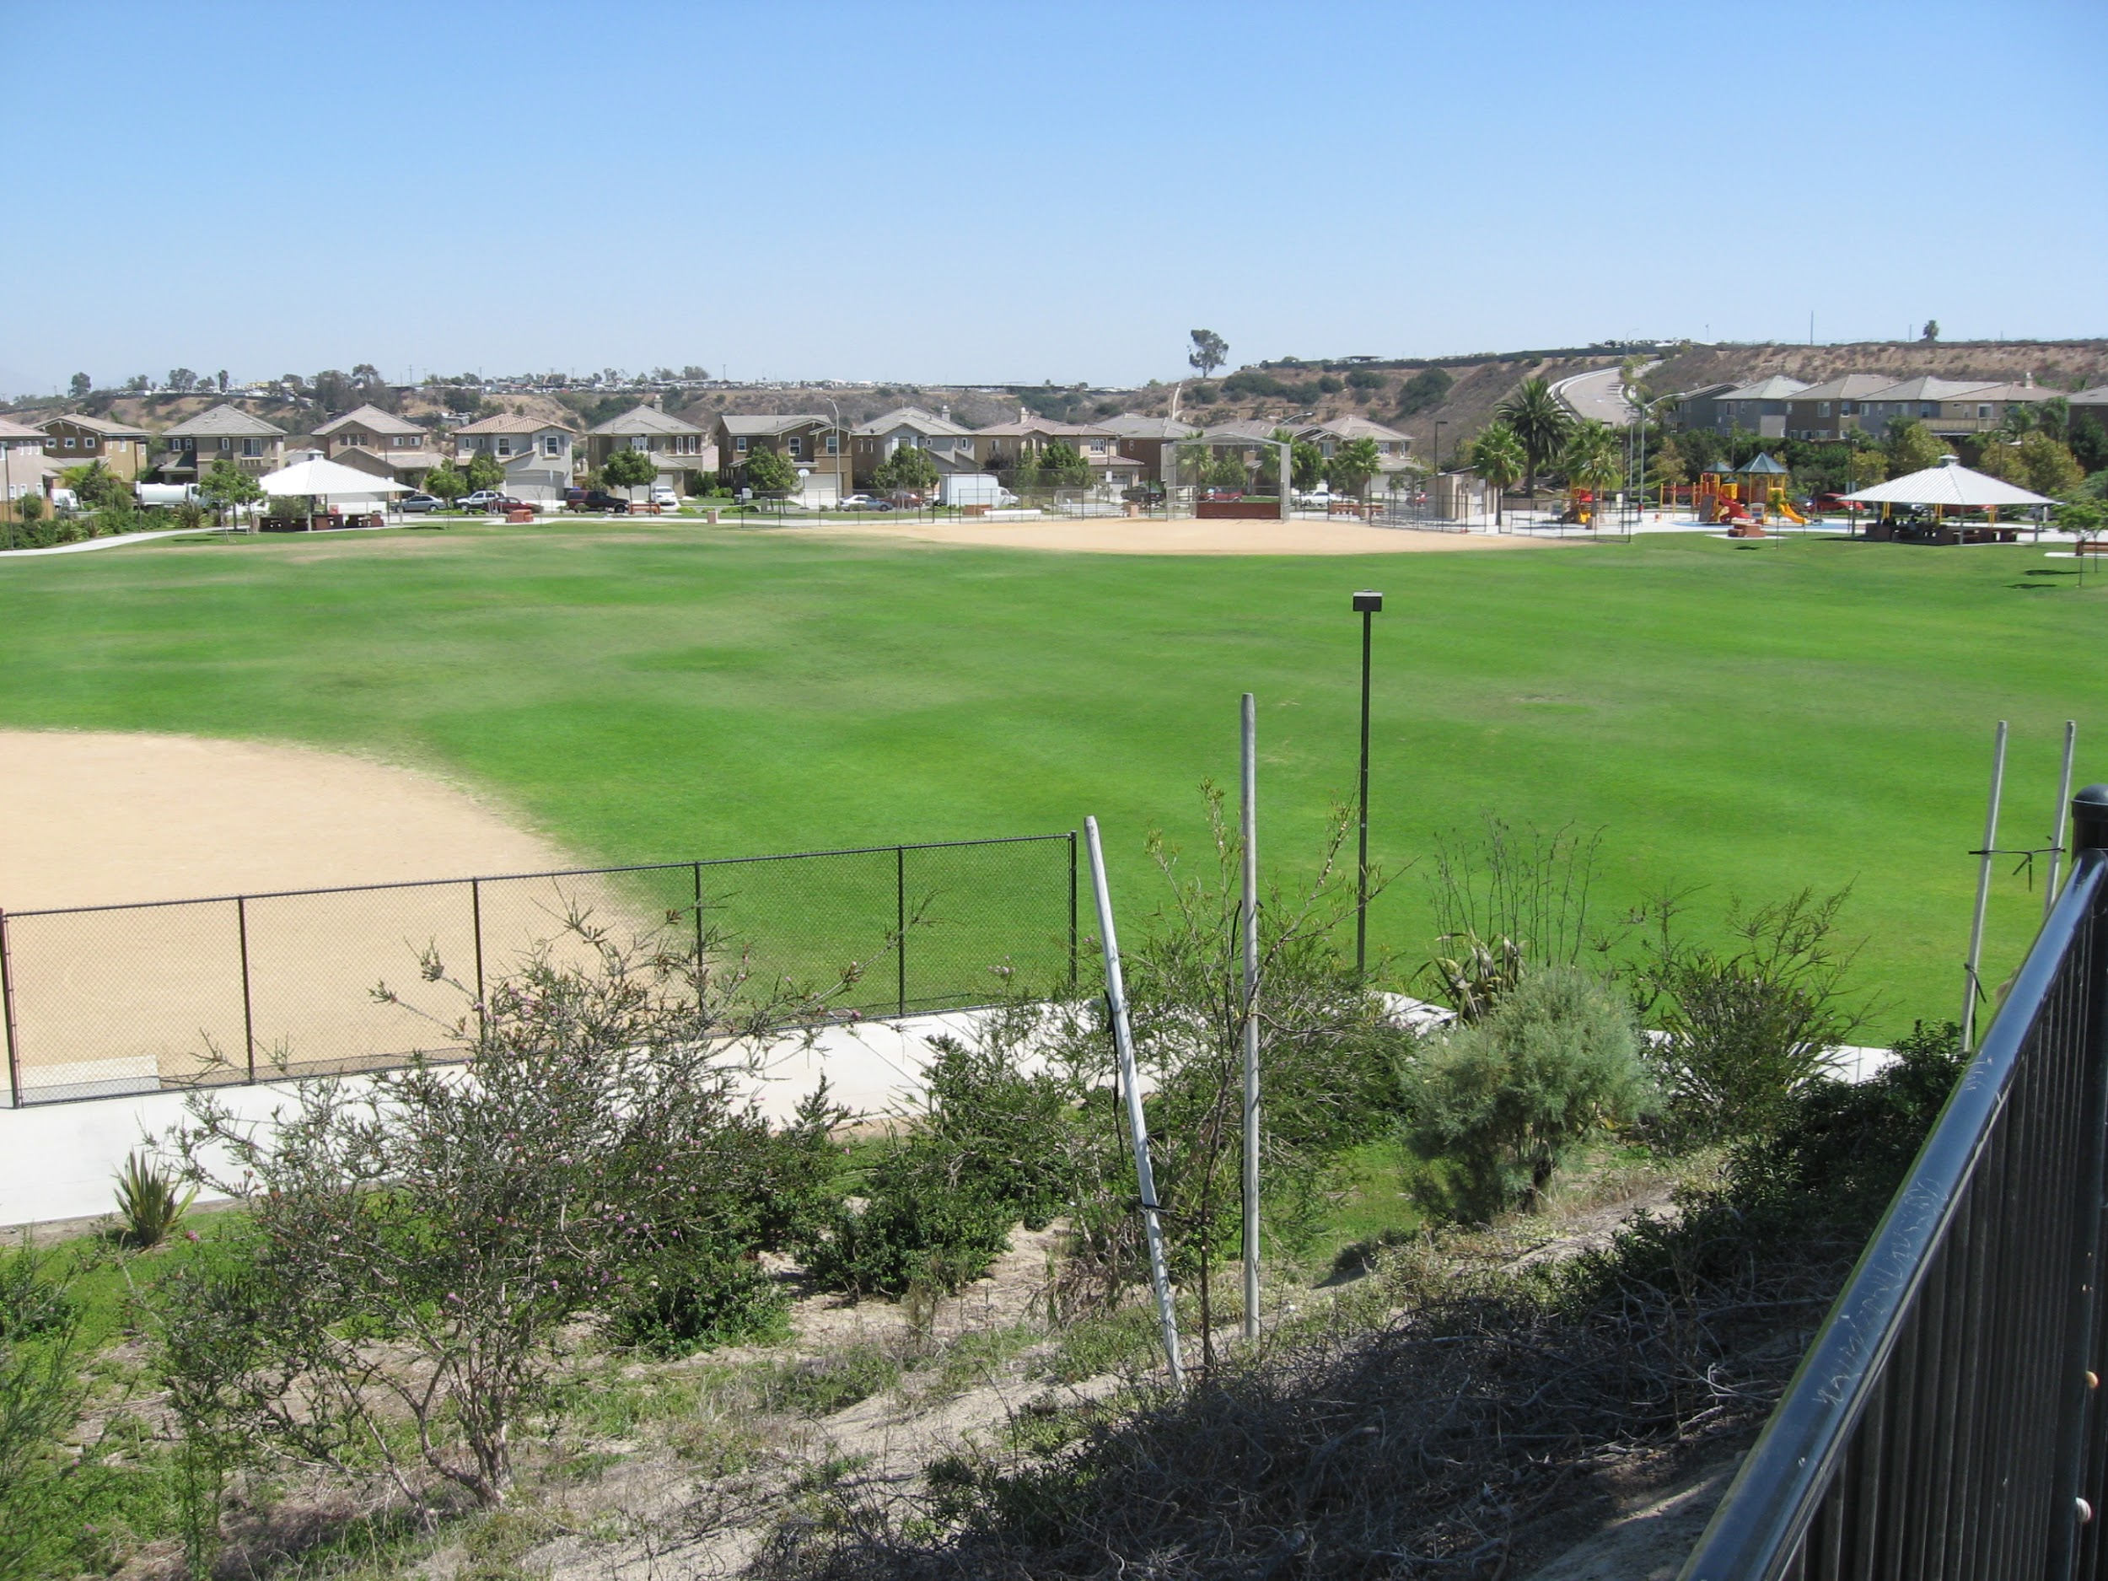
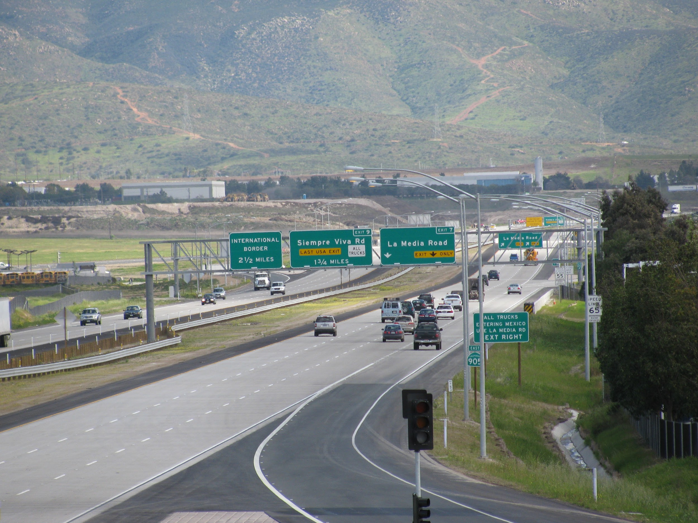
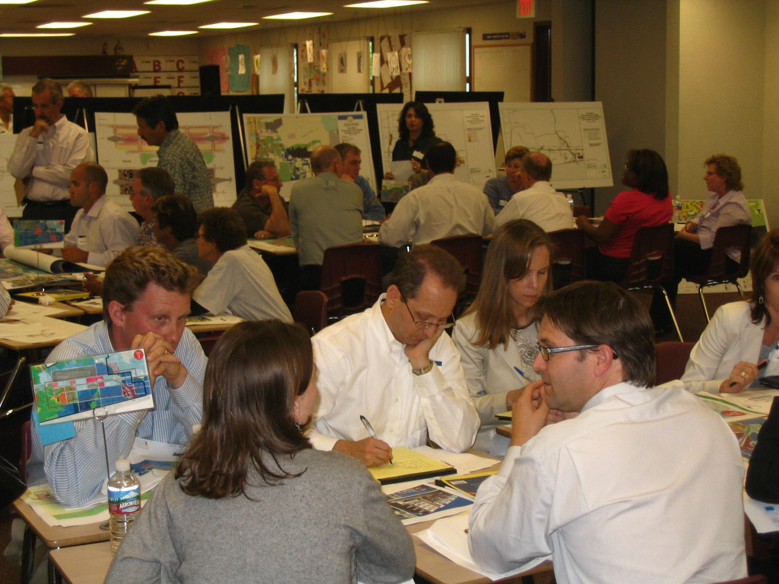
Otay Mesa Community Plan Update
Comprehensive Planning Award - Large Jurisdiction
Notes:
Otay Mesa Community Plan Update

Slide 20
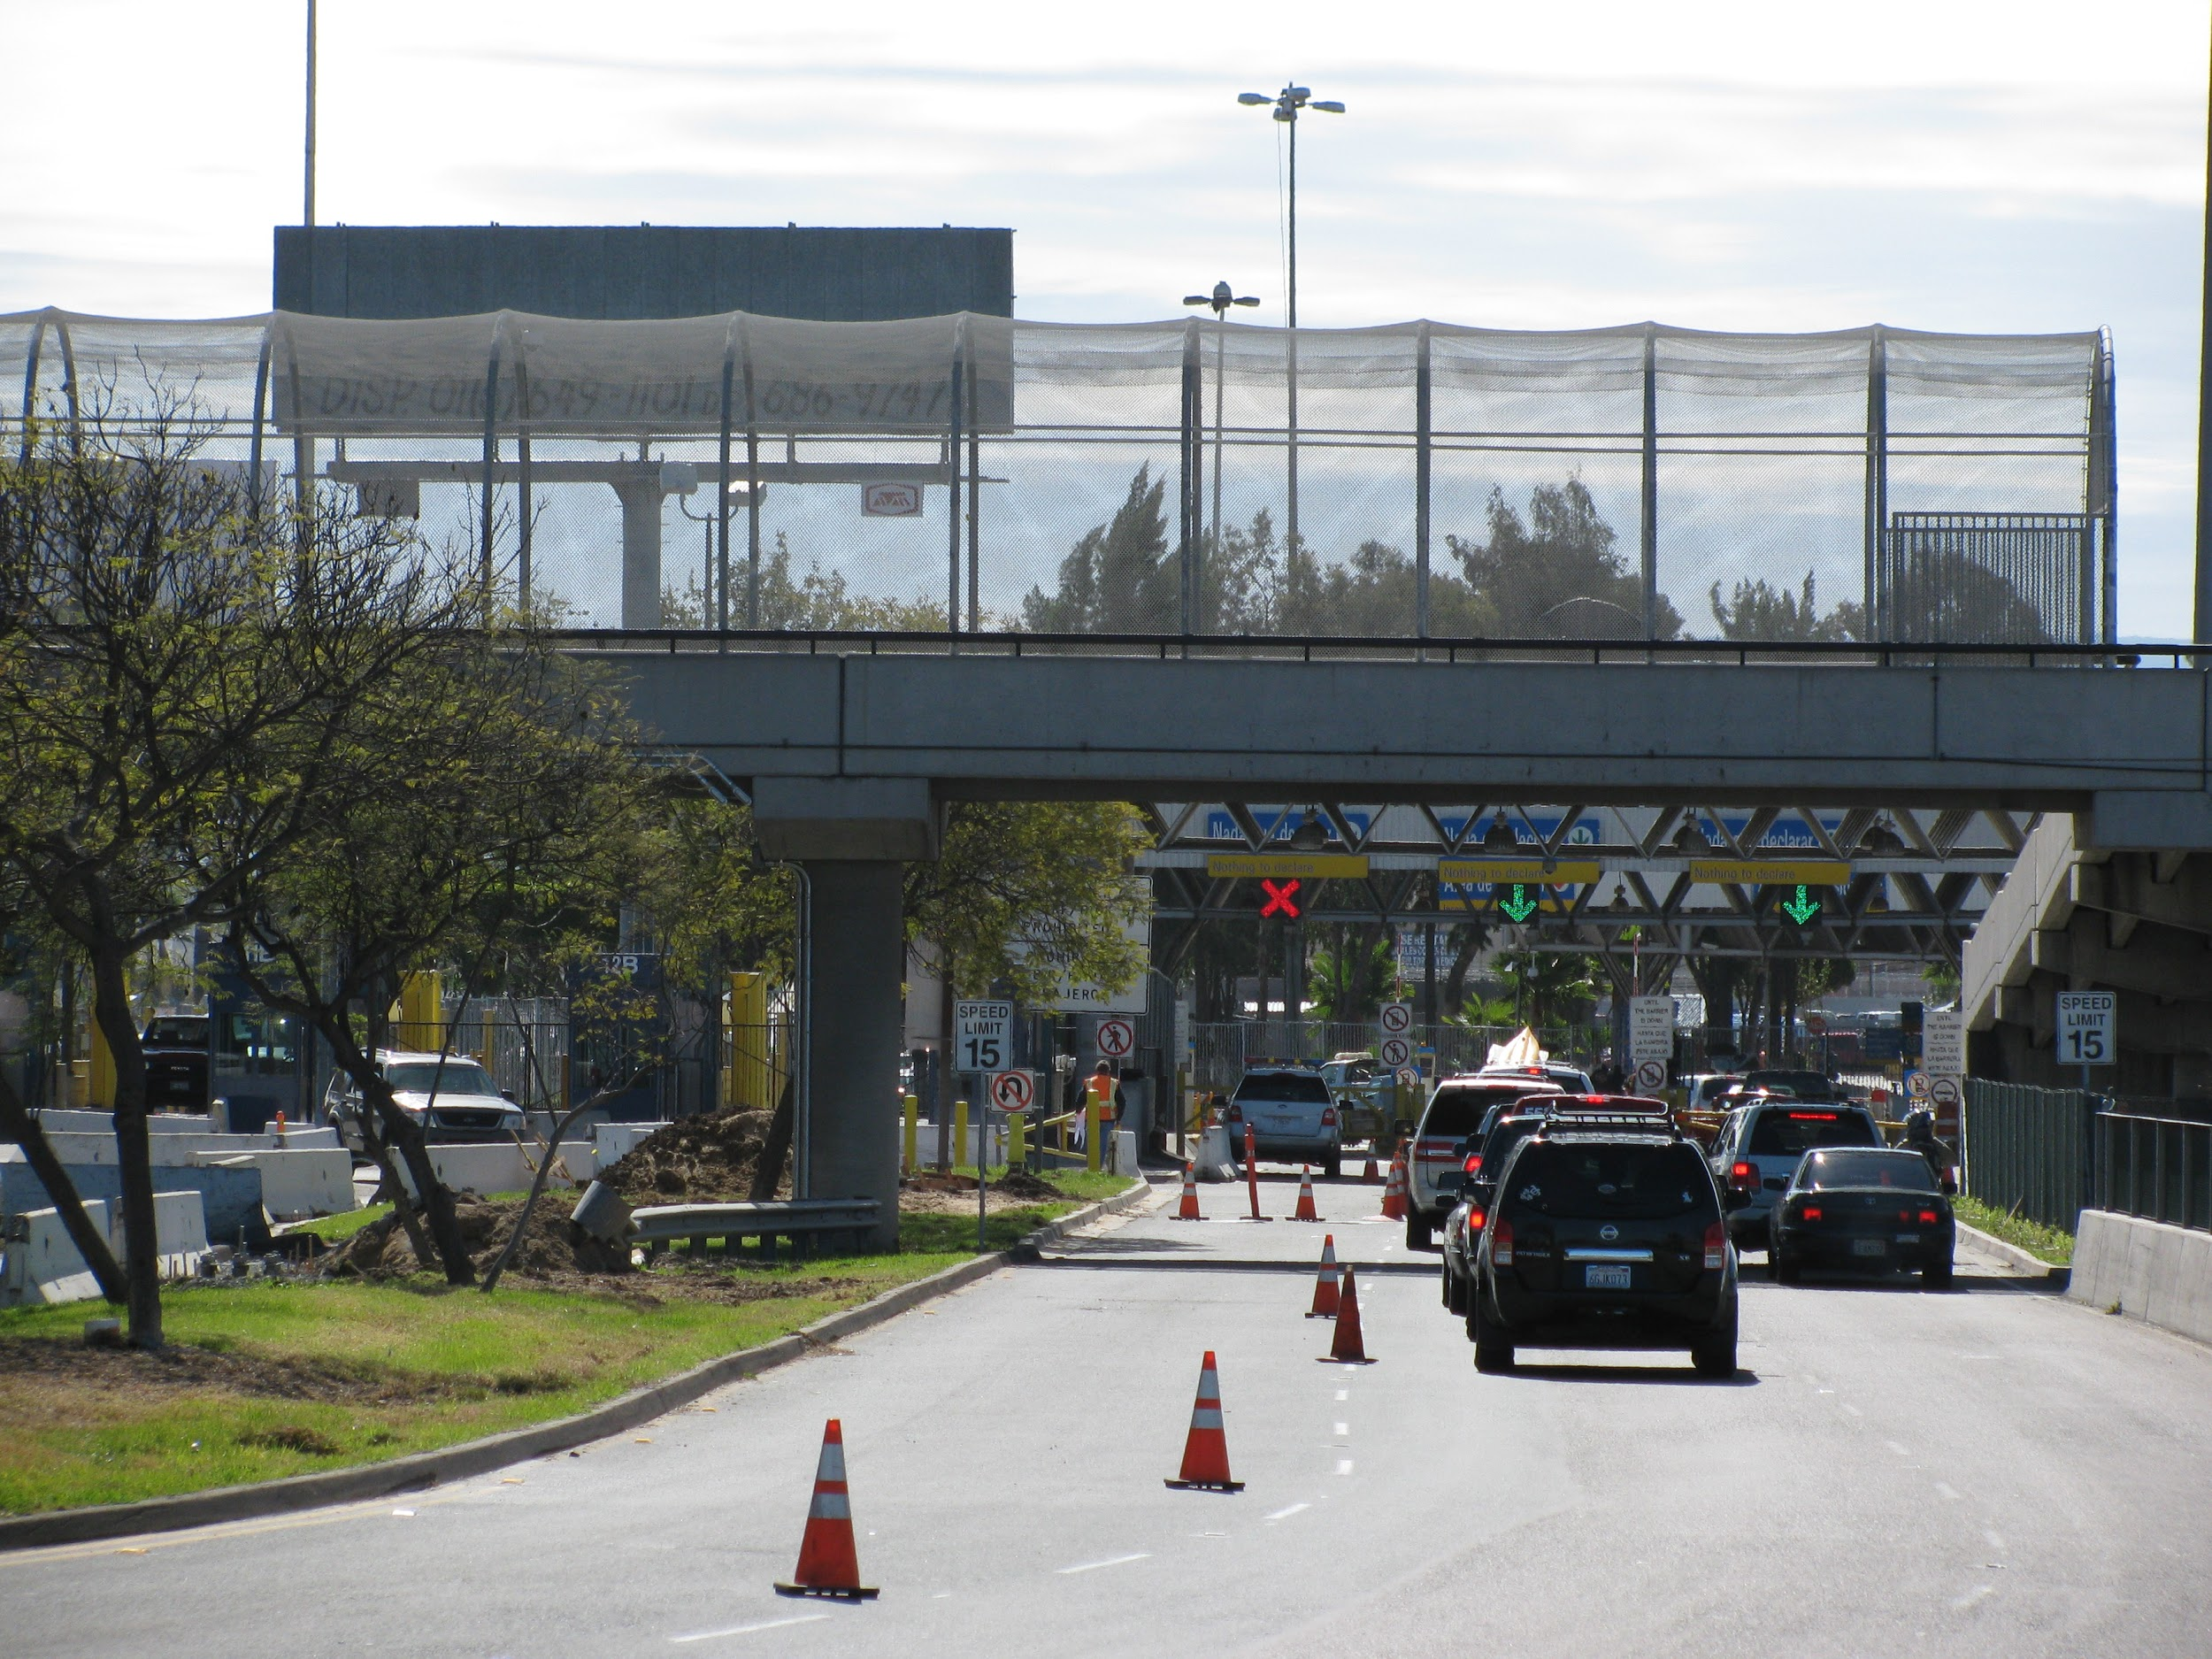
“
The Otay Mesa Community Plan Update provided a unique opportunity to … [evaluate] and [coordinate] a multi-modal transportation network, balancing economic prosperity with housing needs, and coordinating infrastructure financing and phasing with complex land use decisions.”
Notes:
Otay Mesa Community Plan Update

Slide 21
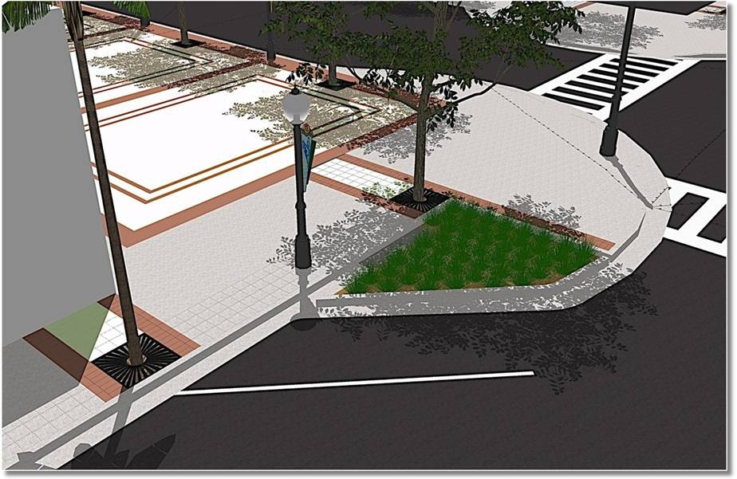
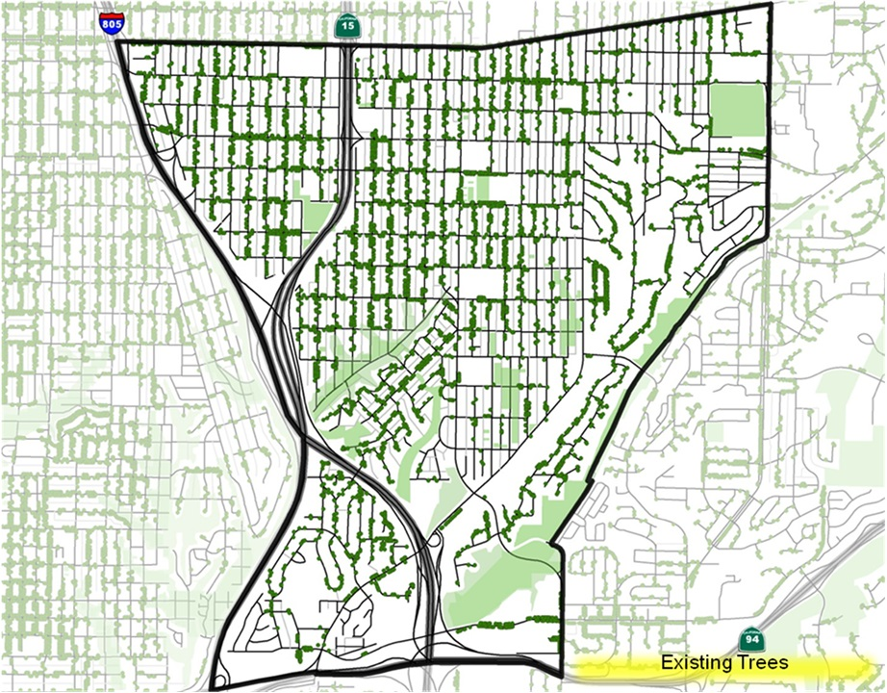
City Heights Urban Greening Plan
Innovation in Green Community Planning
Notes:
City Heights Urban Greening Plan

Slide 22
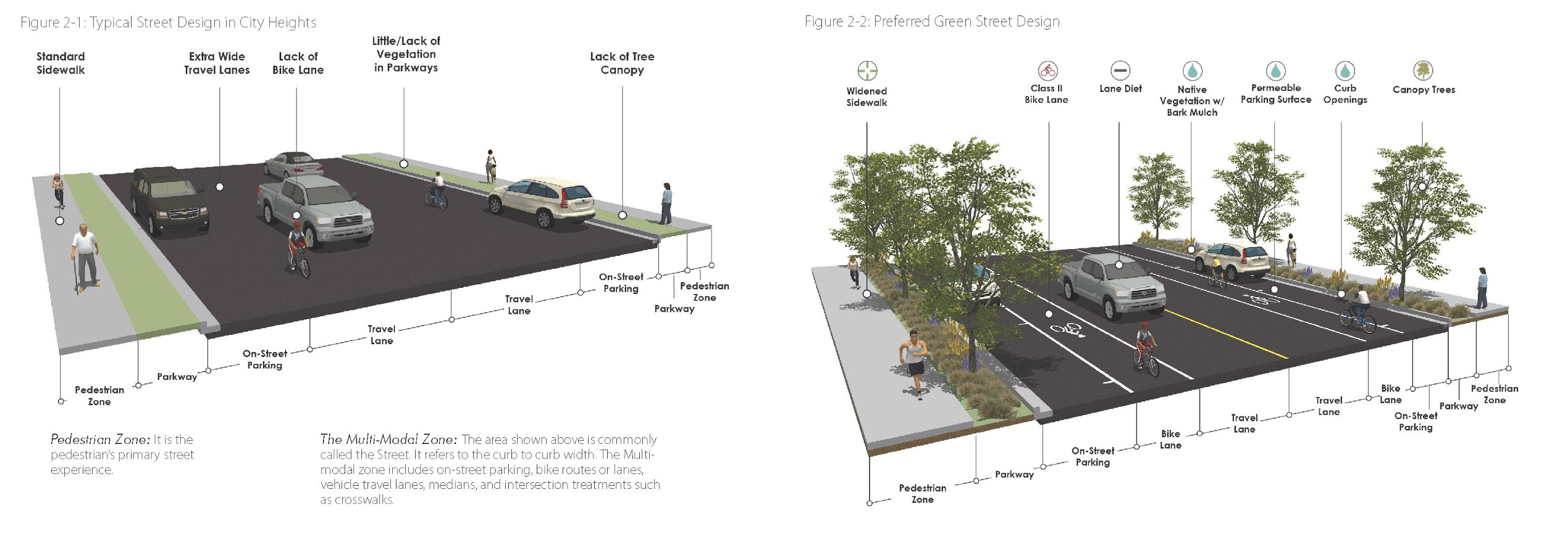
“
The Plan seeks to further increase walking, bicycling, and transit use through improvements to street design. Specific design improvements were developed based on the use, roadway width, and character of each street.”
Notes:
City Heights Urban Greening Plan

Slide 23
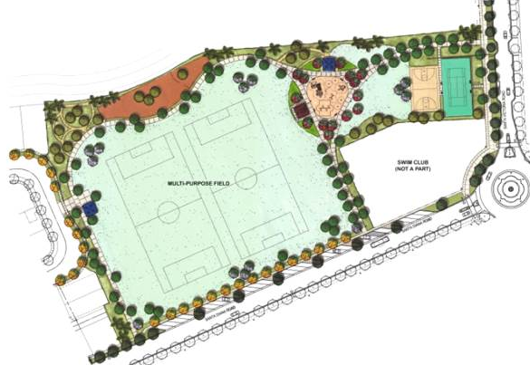
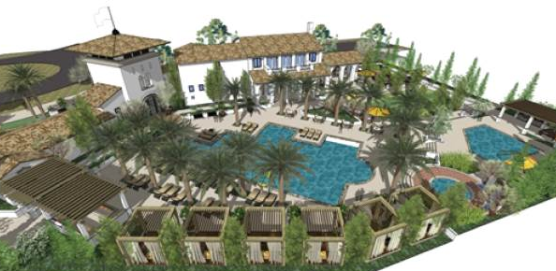
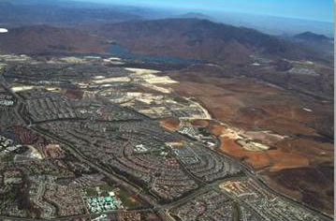
Otay Ranch Village Two
Comprehensive SPA Amendment
Economic Planning and Development
Notes:
Otay Ranch Village Two

Slide 24
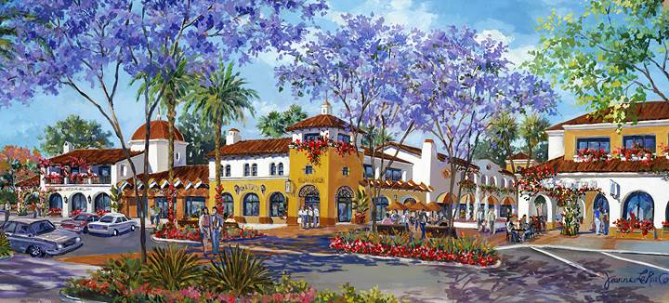
“
The project enhances Otay Ranch Village Two by further establishing a unified, pedestrian-oriented, amenity-rich village plan. It is intended to enhance living, working, learning, shopping, and transit options in the Village while increasing residents’ opportunities for social interaction and recreation.”
Notes:
Otay Ranch Village Two

Slide 25
Raffle Drawing
The Raffle and Silent Auction benefit our Student Scholarship Program.
A second drawing will be held
at the end of the program.

Slide 26

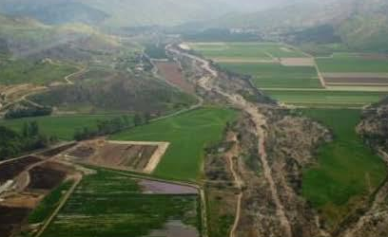
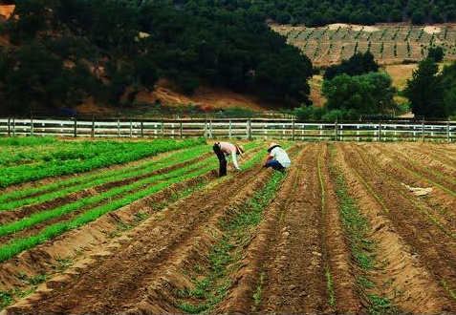
County of San Diego Purchase of Agricultural Conservation Easements (PACE) Program
Best Practices
Notes:
County of SD PACE program

Slide 27
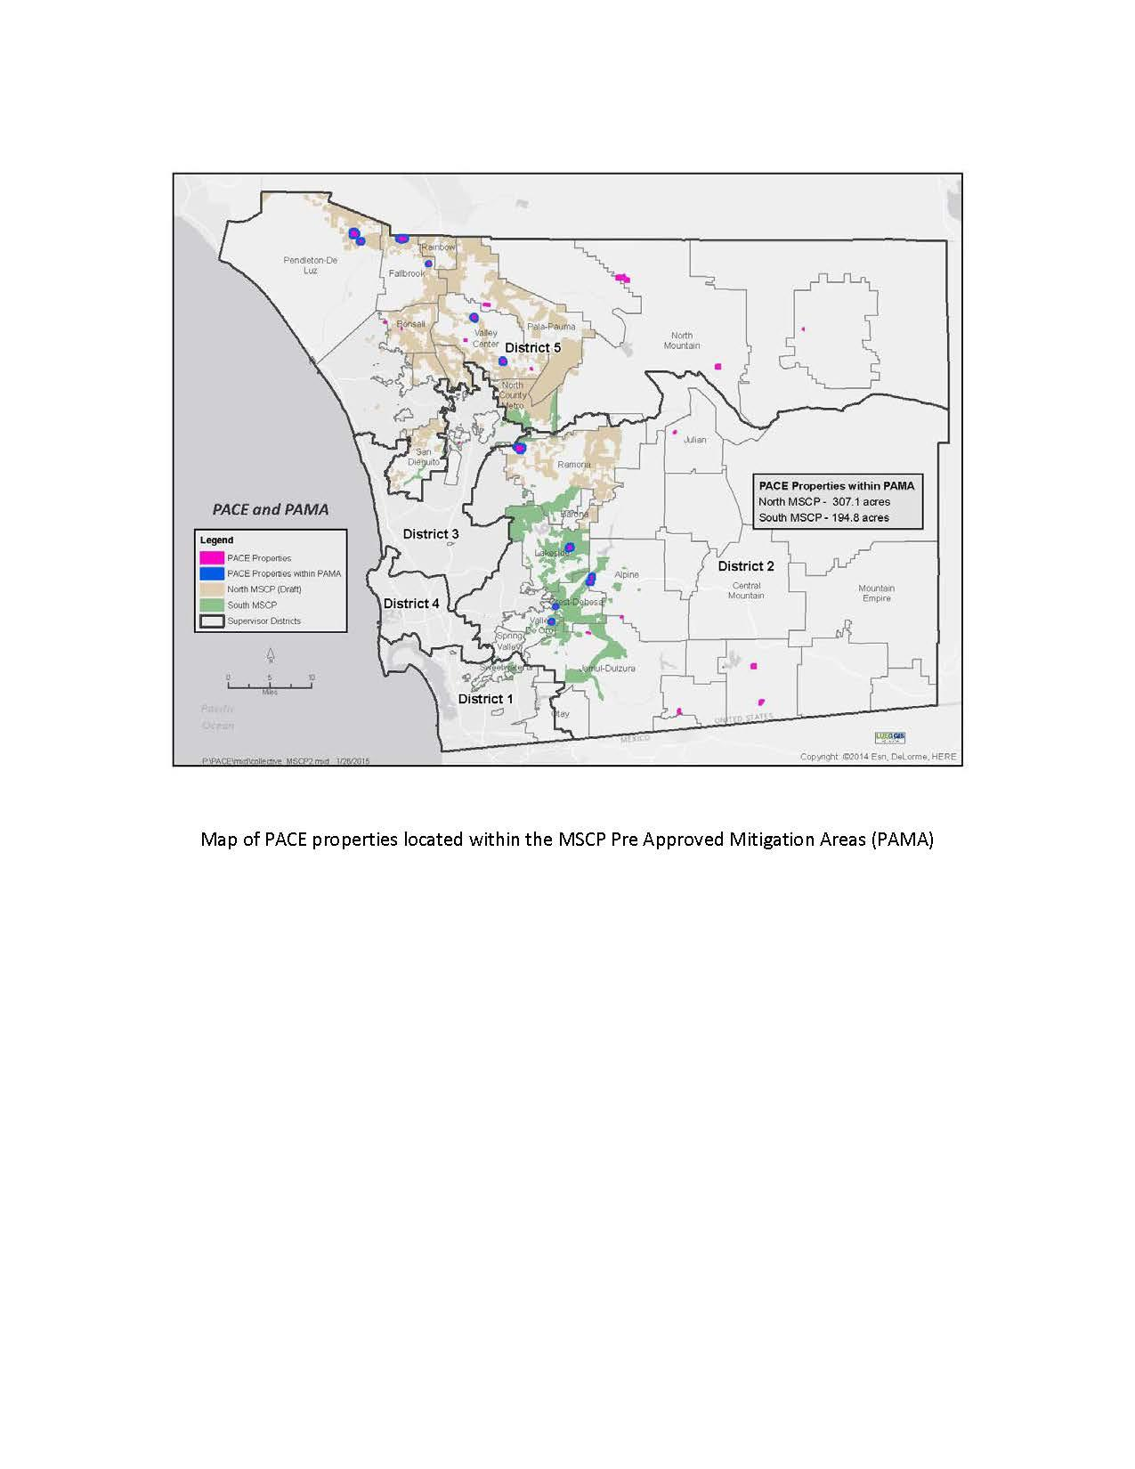
“
The County has preserved 1,151 acres by securing … easements with approximately 500 acres located within Multiple Species Conservation Plan Pre-Approved Mitigation Area. … The PACE program serves as a vital component in on-going County efforts to preserve agricultural lands, an important part of our overall economy and character.”
Notes:
County of SD PACE program

Slide 28
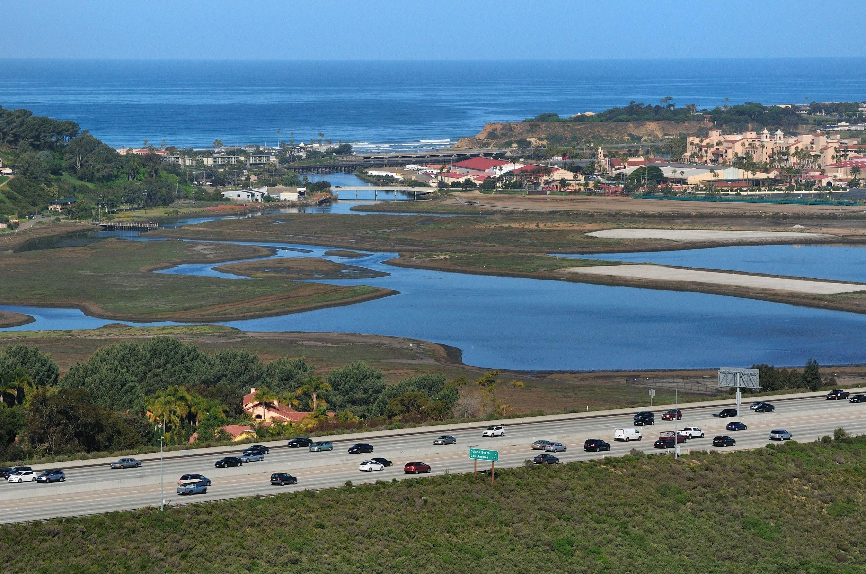
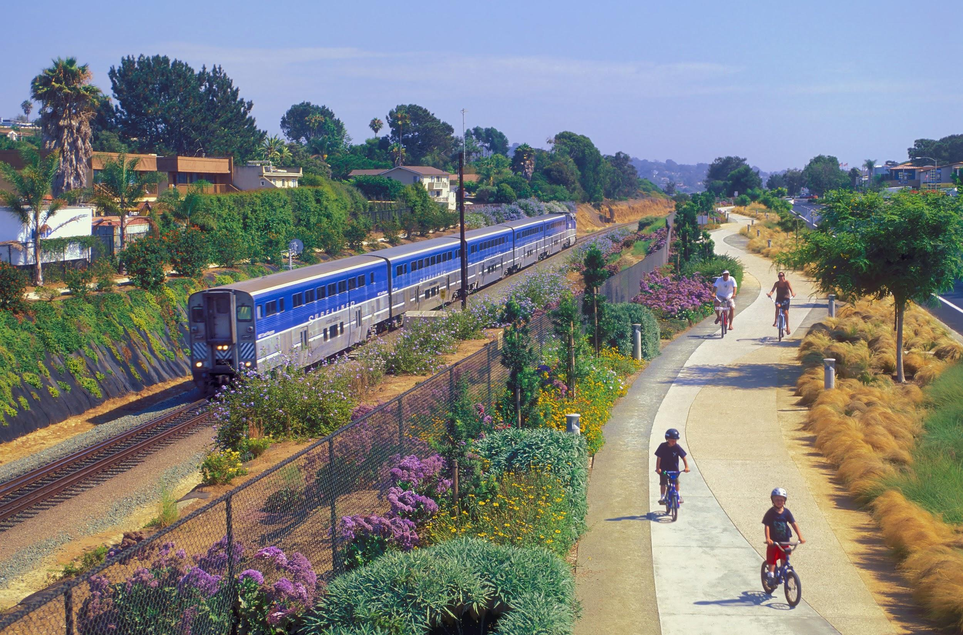
North Coast Corridor
Public Works Plan | Transportation and Resource Enhancement Program
Planning Agency
Notes:
North Coast Corridor

Slide 29
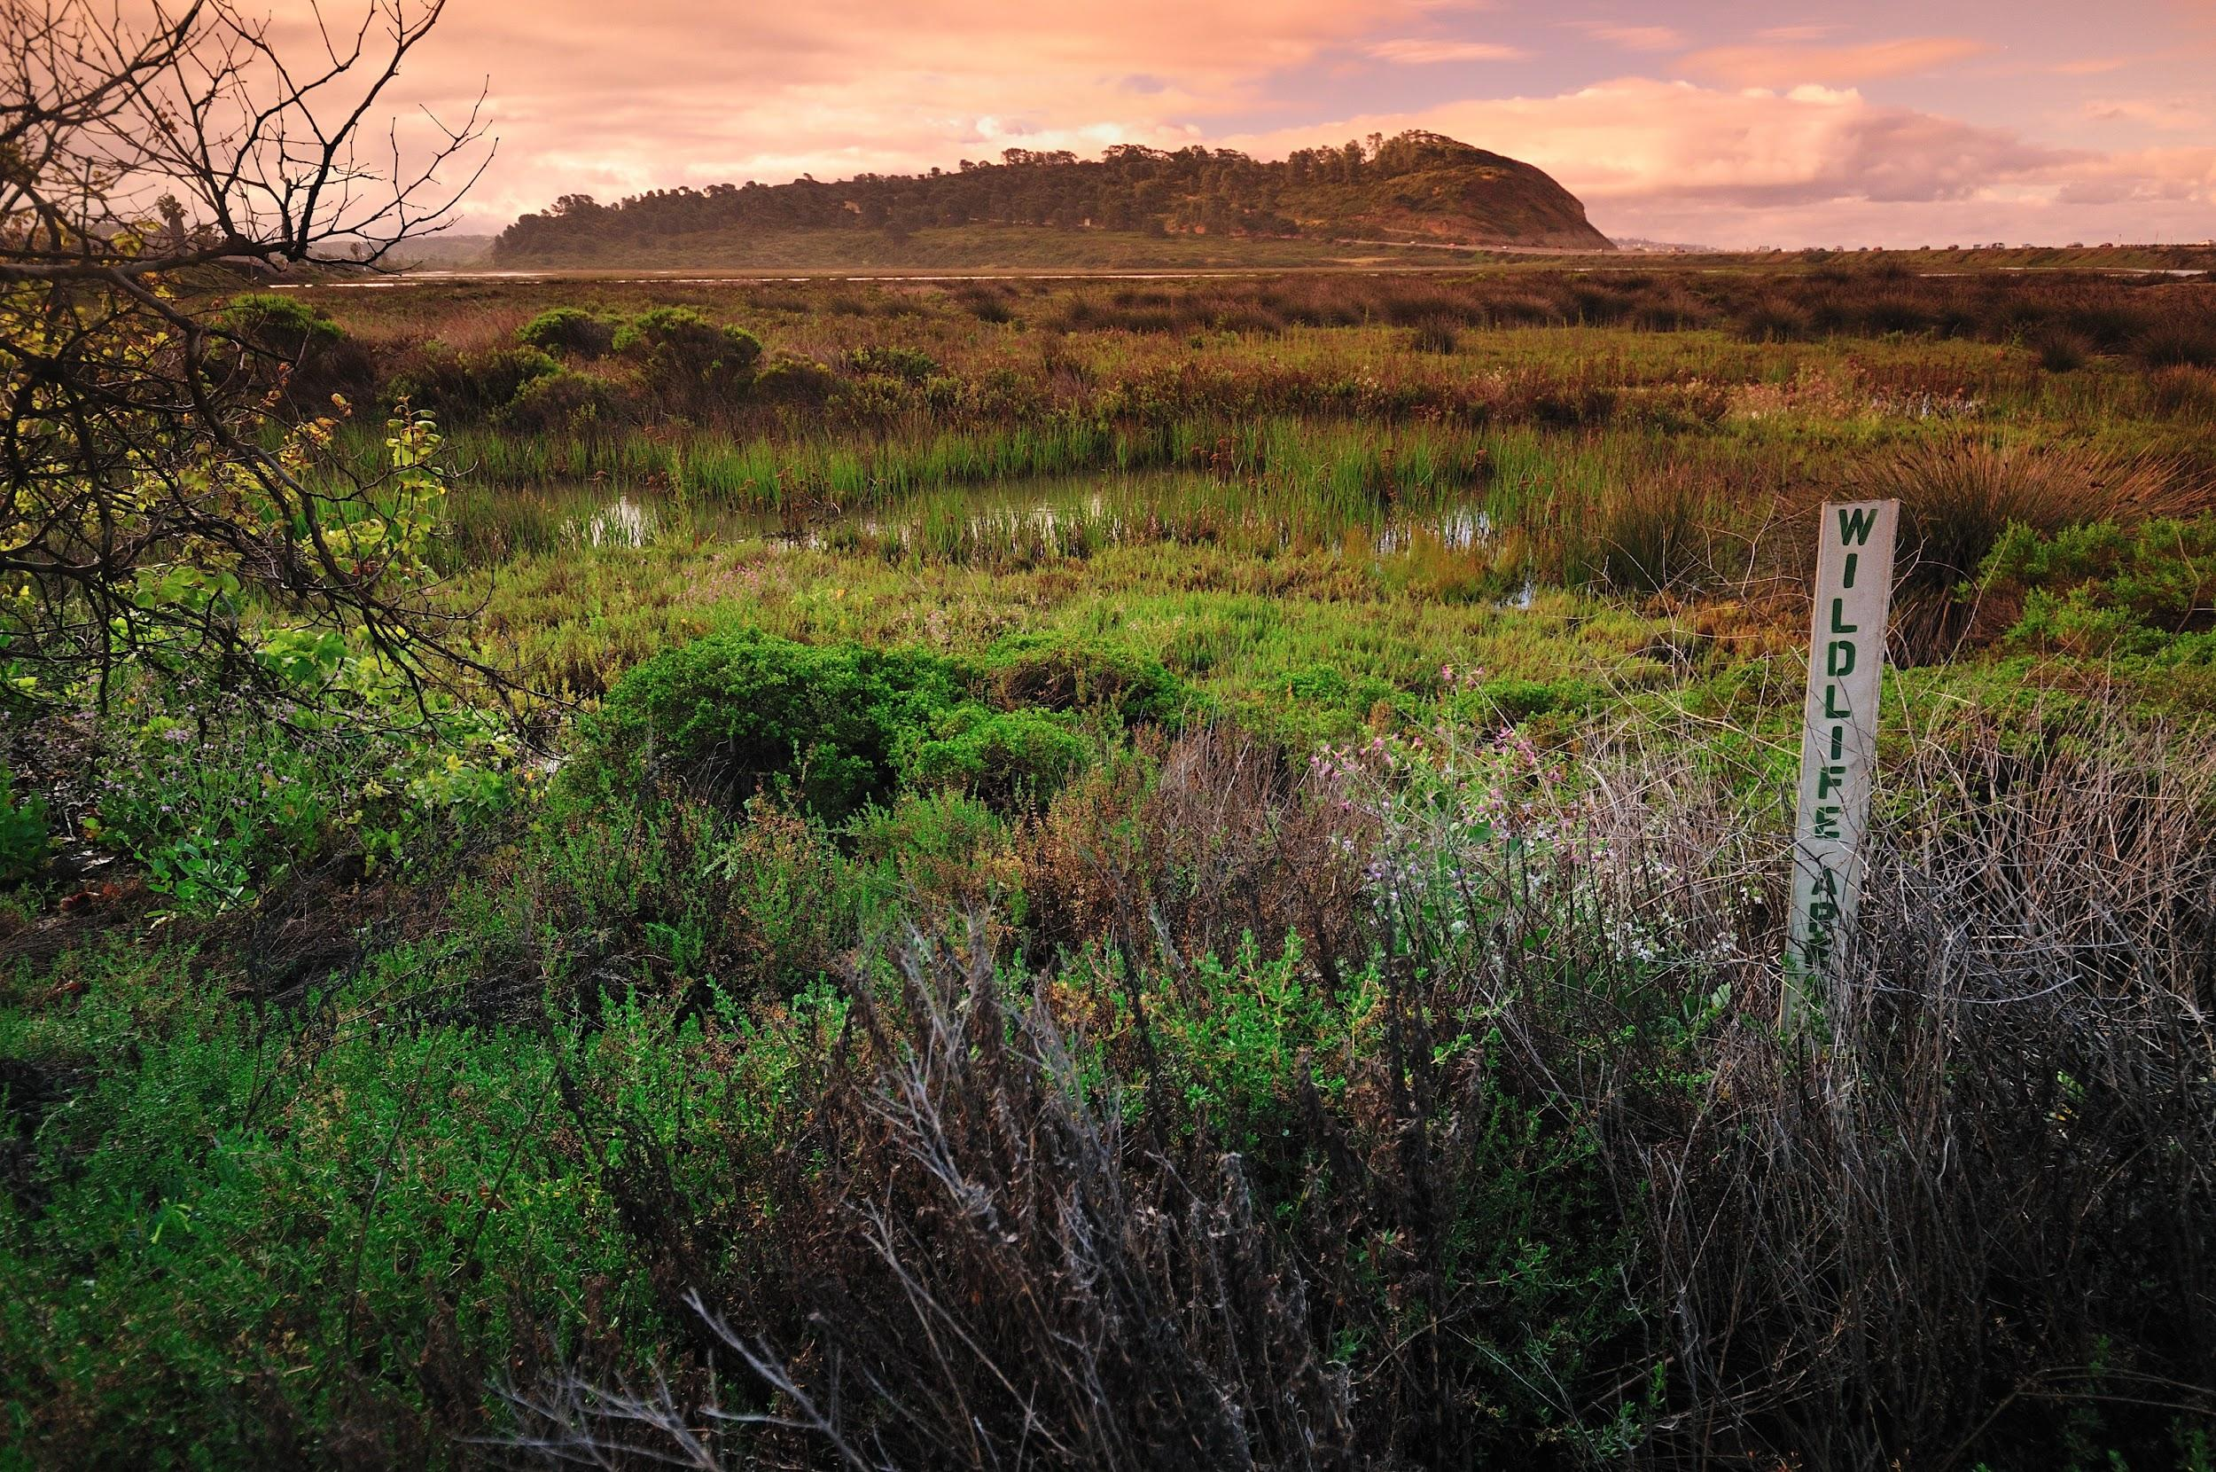
“
This program ensures the continued economic growth of the San Diego region while making a robust effort to provide a variety of safe and reliable transportation options and to protect San Diego’s precious natural resources and aesthetic value.
Notes:
North Coast Corridor

Slide 30
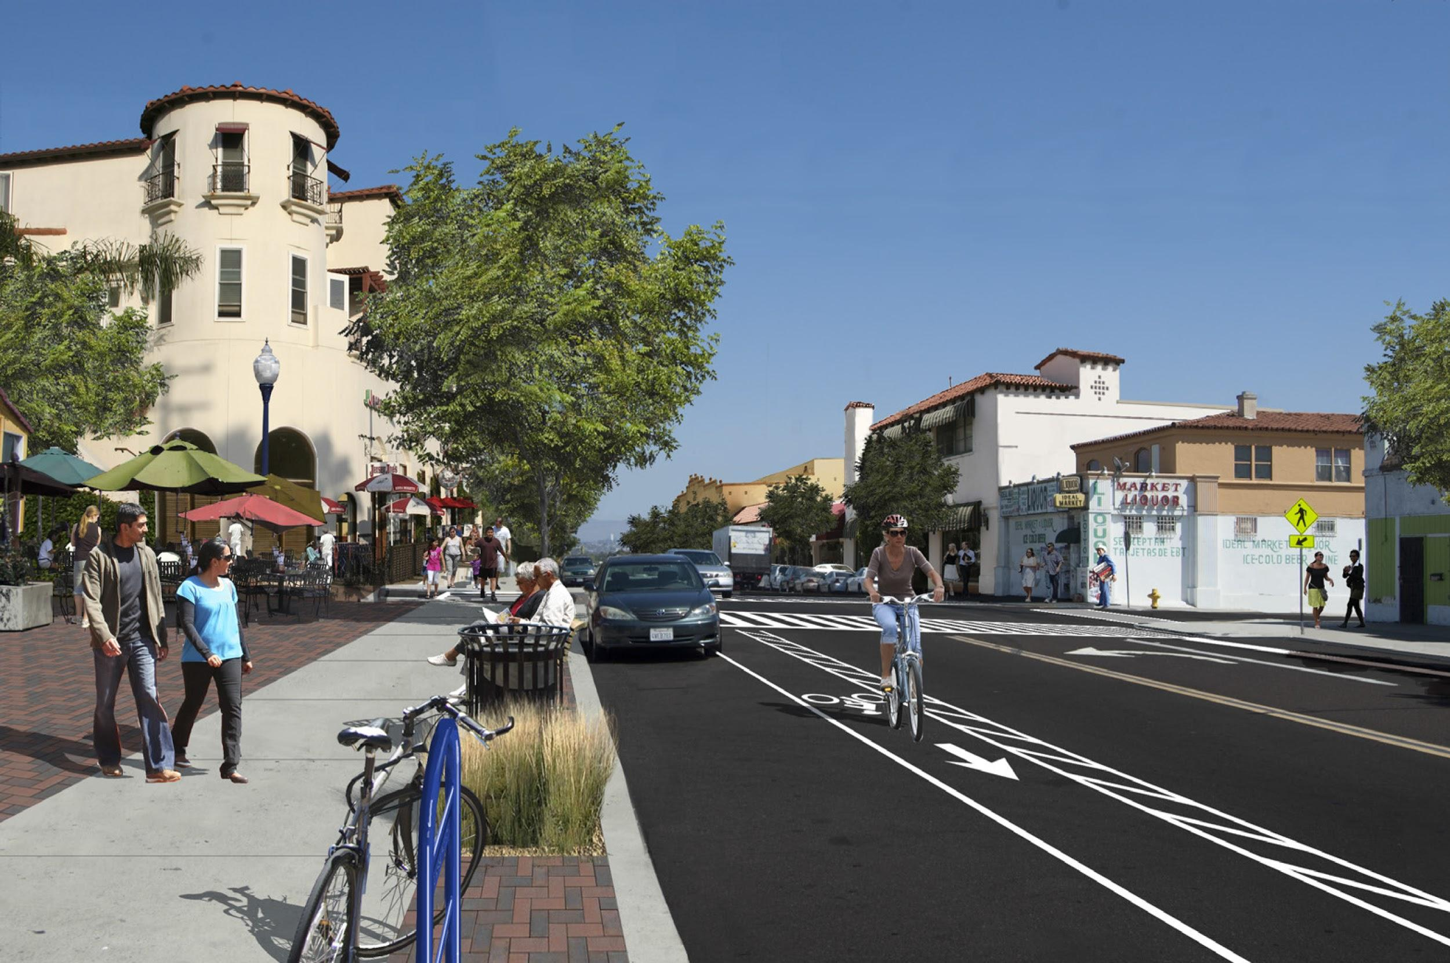
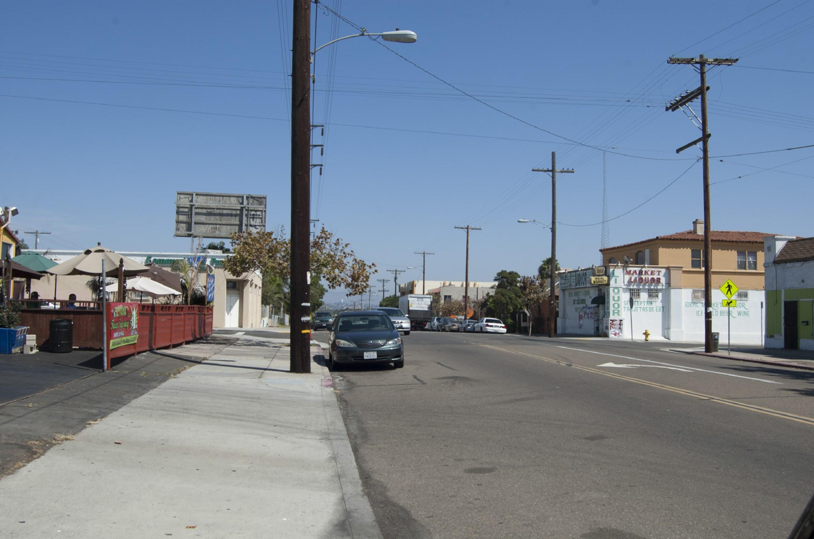
National Avenue and Euclid Avenue Gateway Master Plans (Merit Award)
Communications Initiative
Notes:
National Avenue & Euclid Ave

Slide 31
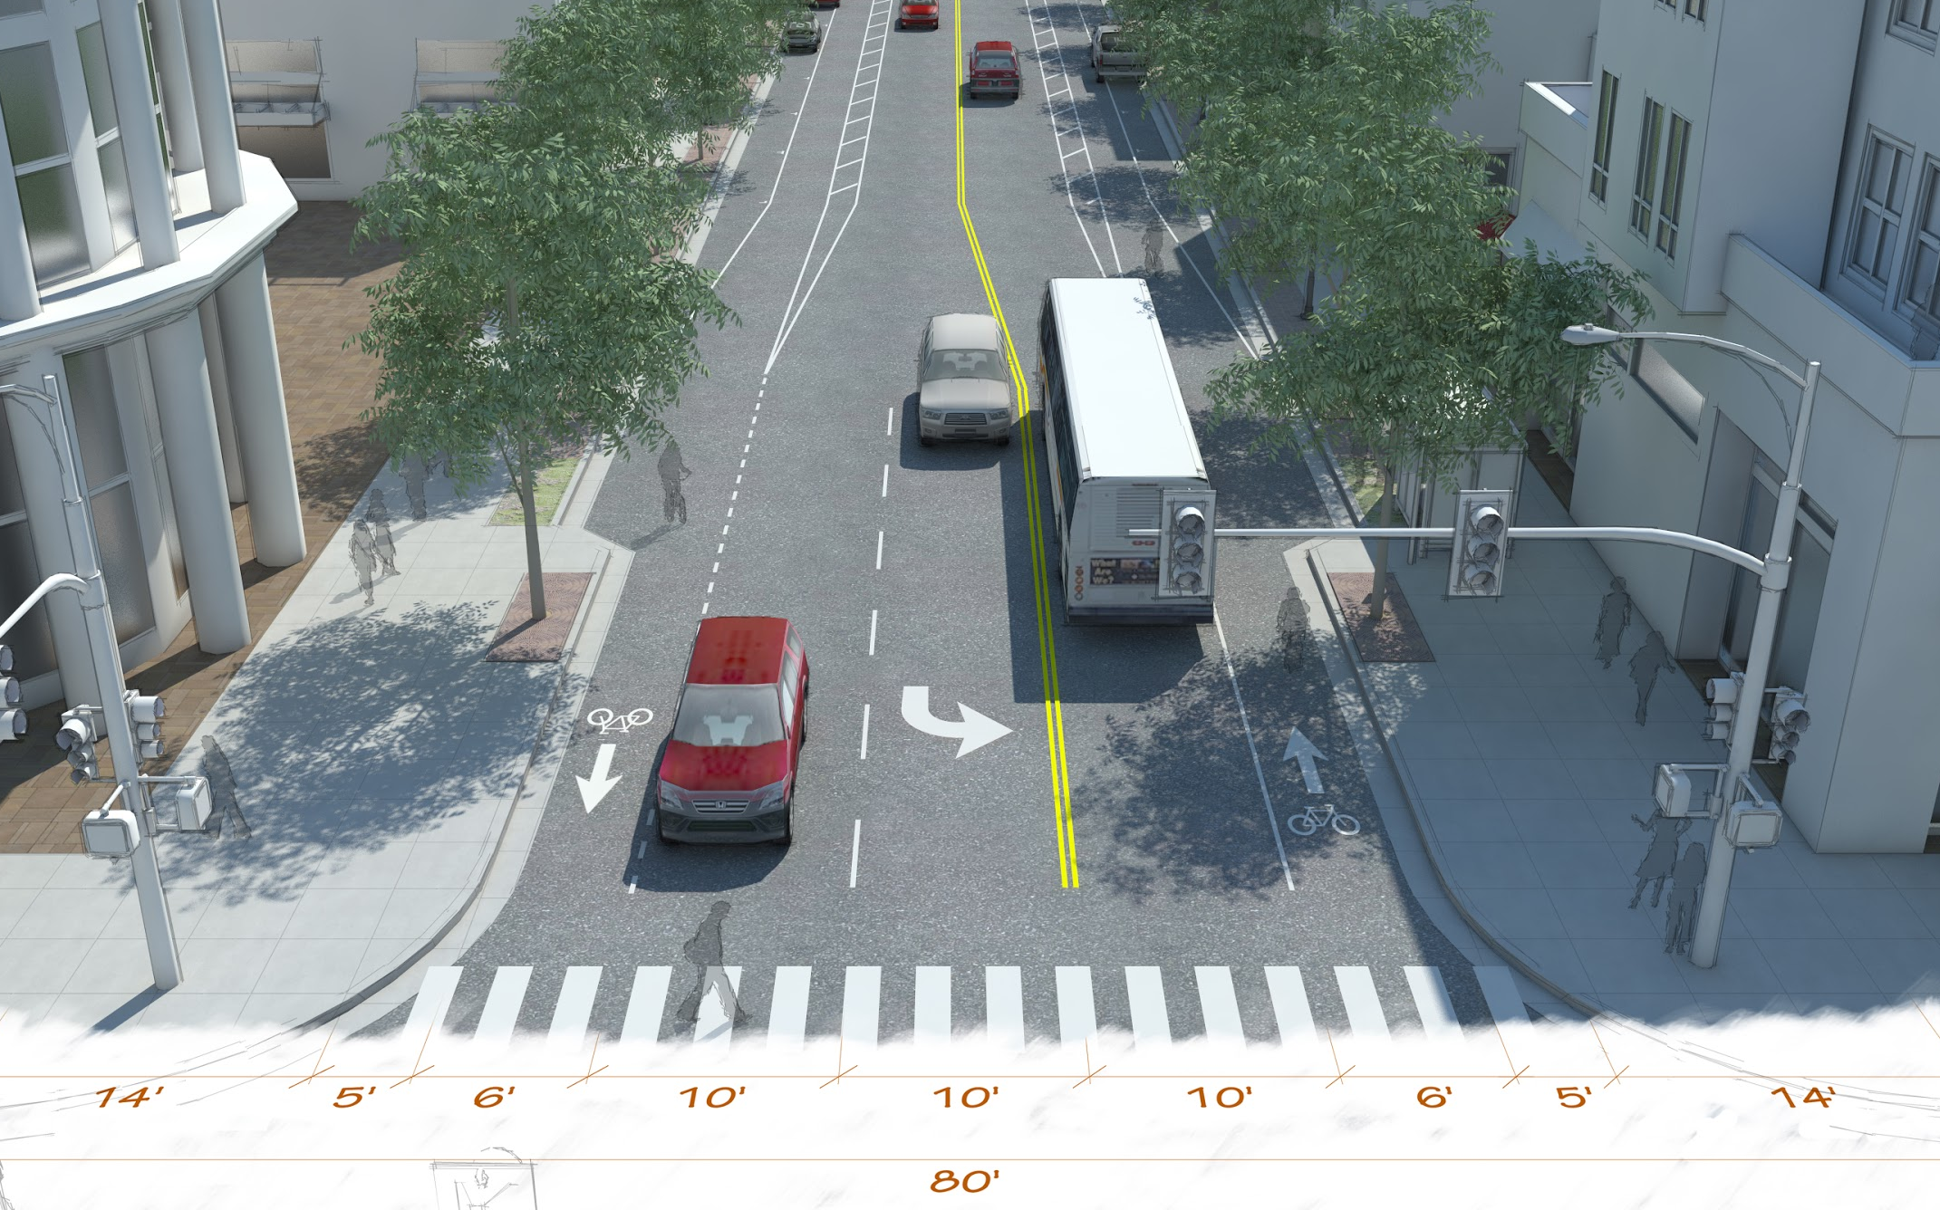
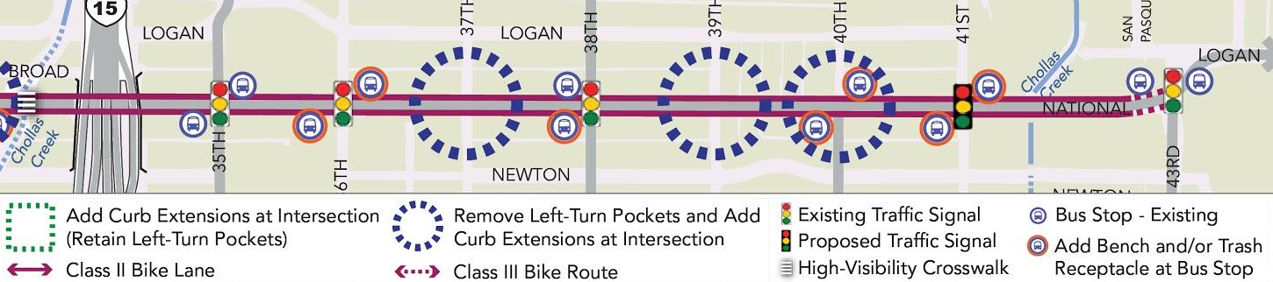
“
The … process [developed] an engaging way of communicating the master plan to the community. Under the City of San Diego’s leadership, the project team established a dynamic, user‐friendly format.... The innovative bilingual poster and Executive Summary present graphically rich urban design concepts that illustrate the vision of the community.”
Notes:
National Avenue & Euclid Ave

Slide 32
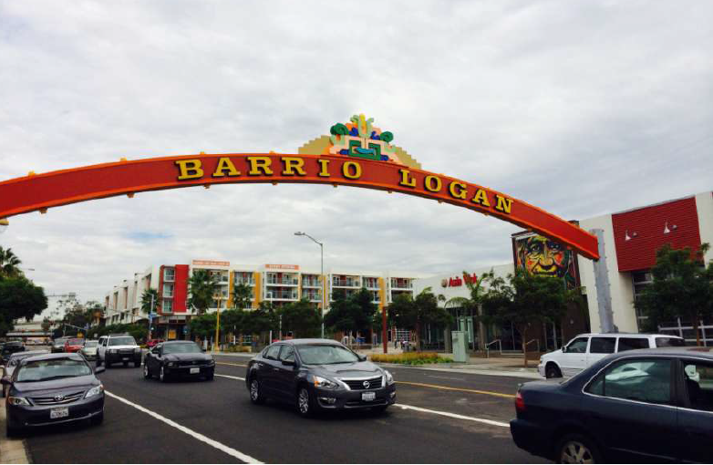
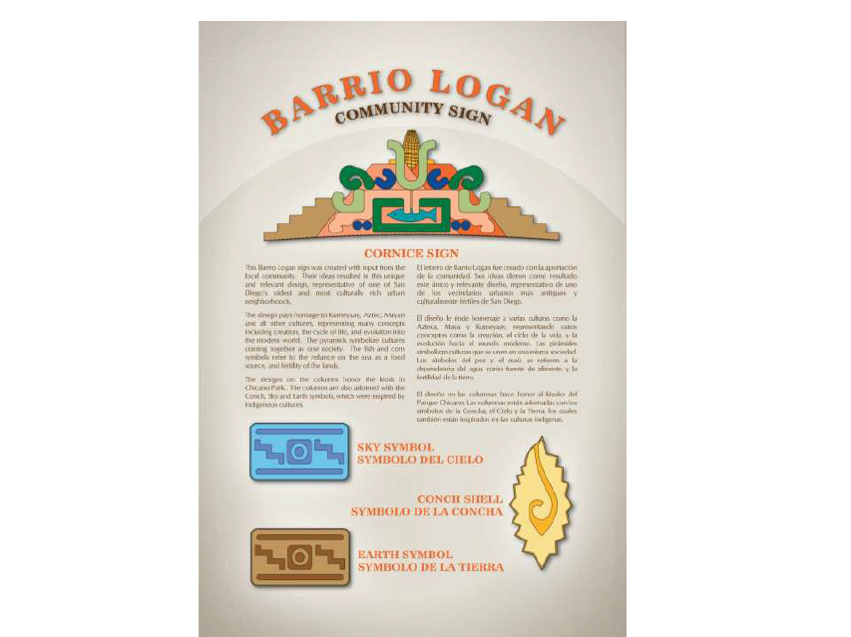
Barrio Logan Gateway Sign
Implementation Award - Large Jurisdiction
Notes:
Barrio Logan Gateway Sign

Slide 33
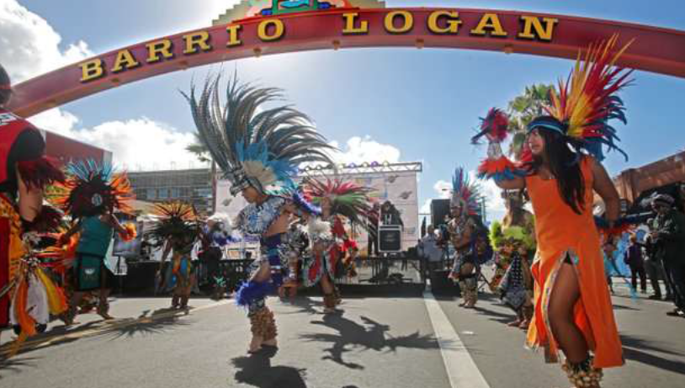
“
Many community stakeholders attended the workshops and ... well known Chicano artists [assisted] in the design.... The community meetings resulted in … input reflecting ‘what the Barrio is all about’. … The … sign was installed in the Fall of 2014 and has become an iconic gateway for the community of Barrio Logan. [It] has also effectively deterred large 5-ton semi trucks from using Cesar Chavez Parkway to access the freeways.”
Notes:
Barrio Logan Gateway Sign

Slide 34


Congratulations to our Scholarship Winners
Meghan Cedeño
Katherine Persons

Slide 35
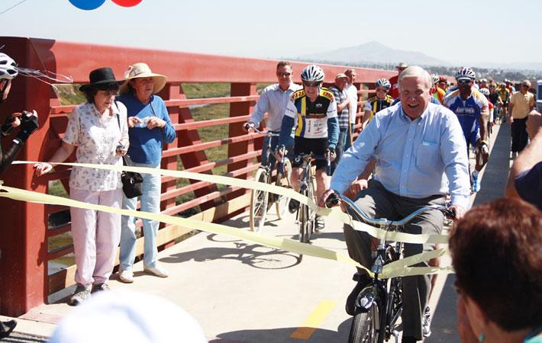
2015 National Award Winner
Supervisor Greg Cox, National Planning Excellence Award for a Planning Advocate
Notes:
National Avenue & Euclid Ave

Slide 36
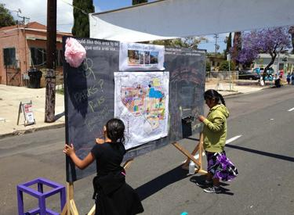
2015 National Award Winner
Pop-up Outreach for the Southeastern San Diego and Encanto Neighborhoods Community Plans - National Planning Achievement Award for Public Outreach
Notes:
National Avenue & Euclid Ave

Slide 37
Final Raffle Drawing
The Raffle and Silent Auction benefit our Student Scholarship Program.

Slide 38
Have a wonderful night!

