Slide 1
SB 743 CEQA Guidelines Update
Governor’s Office of Planning and Research

Slide 2
Topics
What future do we want for California?
Issues with LOS in CEQA raised by stakeholders
What does SB 743 do?
New Primary Metric: Vehicle Miles Traveled
Draft CEQA Guidelines implementing SB 743
Models and technical considerations
Estimating the VMT effect of roadway expansion
Implementation Logistics

Slide 3
Looking Forward…
Where will Californians
Live?
Work?
Recreate?
Notes:
Looking forward over the next few decades, when we are expected to reach 50 million people, we need to start asking where do we think people will live, work, etc.

Slide 4
Growing Urban Footprint
Notes:
Our historic growth pattern has been out.

Slide 5
General Goal:
Protect natural resources and improve quality of life by directing new growth to existing cities and suburbs

Slide 6
Analysis of infill development using LOS

Slide 7
Analysis of infill development using LOS
Relatively little vehicle travel loaded onto the network

Slide 8
Analysis of infill development using LOS
Relatively little vehicle travel loaded onto the network
…but numerous LOS impacts

Slide 9
Analysis of greenfield development using LOS

Slide 10
Analysis of greenfield development using LOS
Typically three to four times the vehicle travel loaded onto the network relative to infill development

Slide 11
Analysis of greenfield development using LOS
Typically three to four times the vehicle travel loaded onto the network relative to infill development
…but relatively few LOS impacts
Traffic generated by the project is disperse enough by the time it reaches congested areas that it doesn’t trigger LOS thresholds, even though it contributes broadly to regional congestion.

Slide 12
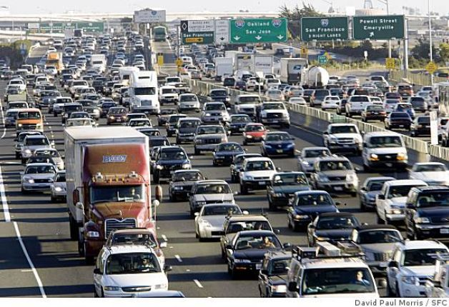
Problems with LOS
1. Bias against infill because of “last-in development” problem
Infill loads relatively little traffic onto the regional network
However, LOS methodology adds traffic generated by infill to existing traffic, triggering thresholds
2. Scale of analysis is too small
Registers impacts adjacent to project, ignores impacts regionally
Spot metric insufficient to show corridor/network impact/benefit

Slide 13
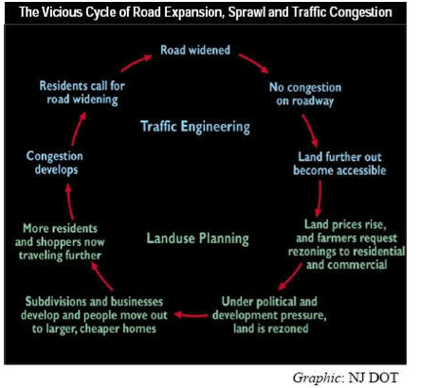
Problems with LOS
3. LOS mitigation is itself problematic
Reducing project size pushes development to outlying locations
Widening roadways worsens livability, induces vehicle travel
4. Mischaracterizes transit, biking, walking as detriments to transportation
A transit priority lane worsens LOS even as it improves person-throughput
LOS characterizes pedestrians and cyclists as obstructions to cars, to be channeled/restricted
2 people
1 person
1 person
40 people

Slide 14
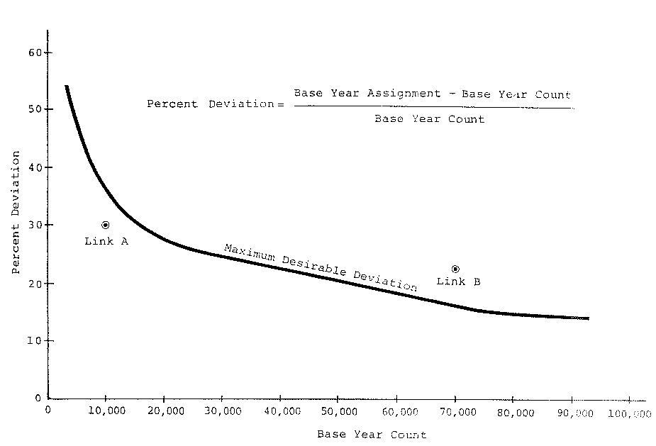
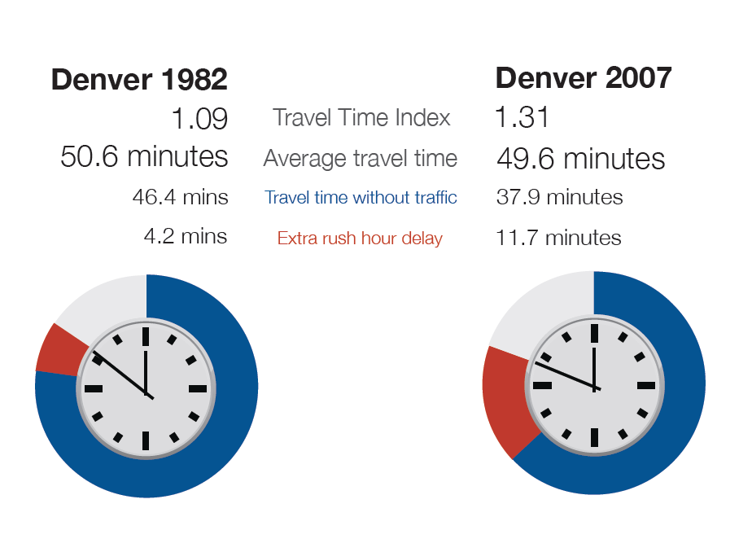
Problems with LOS
From: CDM Smith, Traffic Forecast Guidelines for the 2010s
5. LOS has a well-developed methodology, but is not more precise than other metrics
Trip distribution is difficult to predict accurately
LOS is sensitive to error in trip distribution
6. Delay-based metrics are problematic for modern transportation planning
The purpose of transportation is access to destinations
With smart growth, delay metrics sometimes get that backwards
14

Slide 15
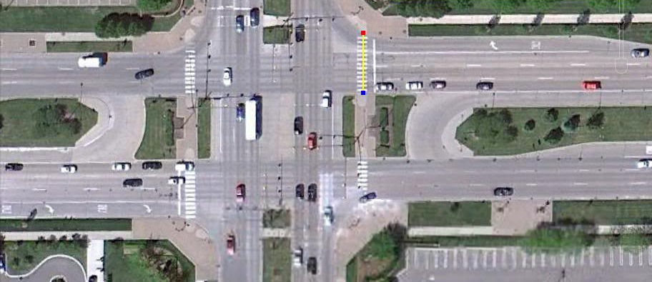
Problems with LOS
7. LOS pushes us to build roads that we cannot afford to maintain
Substantial maintenance shortfalls even for existing roads
Maintaining LOS thresholds creates additional maintenance burden

Slide 16
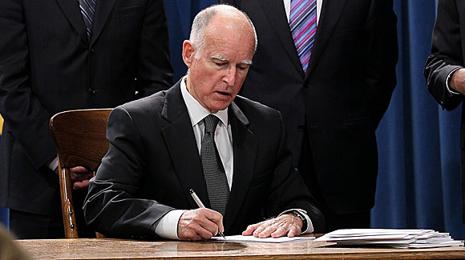
SB 743
Requires the Office of Planning and Research to develop new metrics for transportation impacts under CEQA

Slide 17
SB 743 - Specifics
Requires a change in the status quo to be codified in the CEQA Guidelines
New metric required in transit areas at a minimum
LOS or delay may be used only if/where OPR specifies, otherwise no longer a CEQA impact
Air, noise, safety impacts from transportation still CEQA impacts
Does not pre-empt local planning requirements, fee programs
OPR must specify criteria for a new metric, which must promote:
Reduction in GHGs
Development of multimodal transportation networks
A diversity of land uses

Slide 18
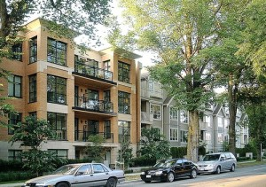
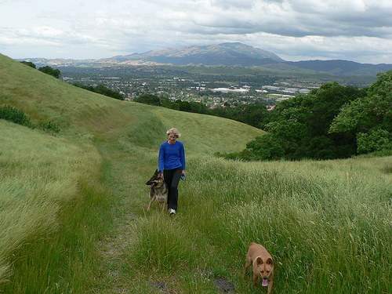
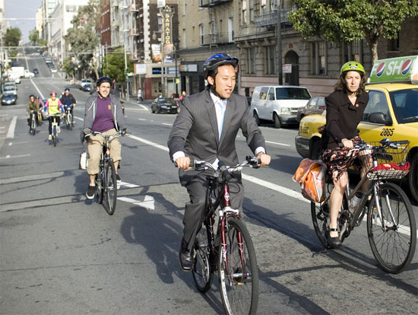
SB 743 - Objectives
Other policy and administration goals
Consistency with State Planning Priorities (Infill priority)
General environmental benefit
Improved Health
Fiscal benefit
Simplicity/feasibility
Access to destinations

Slide 19
Candidate Metrics
Vehicle Miles Traveled*
Automobile Trips Generated*
Multi-modal Level of Service
Fuel use
Vehicle Hours Traveled
Presumption of less than significant transportation impact based on location
* Recommended for consideration by the statute

Slide 20
Vehicle Miles Traveled
Easier to model
Many existing models
Already calculating as part of estimating GHGs
Better accuracy
Captures full extent of vehicle travel
Mitigation doesn’t induce more vehicle travel
Mitigation forwards other environmental and human health factors
Consistent with a broad array of other goals, including fiscal health

Slide 21
VMT, Environment, Health, Cost
Environment
Emissions
GHG
Regional pollutants
Energy use
Transportation energy
Building energy
Water
Water use
Runoff – flooding
Runoff – pollution
Consumption of open space
Sensitive habitat
Agricultural land
Health
Collisions
Physical activity
Emissions
GHGs
Regional pollutants
Mental health
Cost
Increased costs to state and local government
Roads
Other infrastructure
Schools
Services
Increased private cost
Housing supply/demand mismatch → future blight

Slide 22
743 Preliminary Draft CEQA Guidelines Update
Primary Metric for CEQA Transportation Analysis: VMT
Continue to analyze impacts resulting from transportation
Noise
Air Quality
Safety
Delay no longer an impact under CEQA
“A project’s effect on automobile delay does not constitute a significant environmental impact”
Proposed Section 15064.3

Slide 23
Transportation Impacts of Land Use Projects
Old: LOS on local intersections and highway segments
New: VMT loaded onto the roadway network
Possibly LTS if near transit
Possibly LTS if reducing area-wide VMT
Possibly significant if > regional average VMT (per capita, per employee, etc.)
Methodology: deference to lead agency, rule of reason
Proposed Section 15064.3(b)(1)

Slide 24
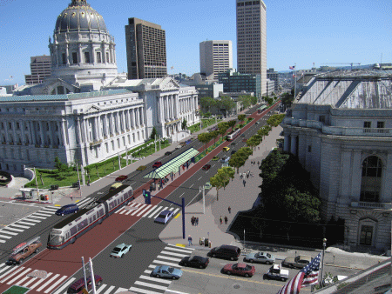
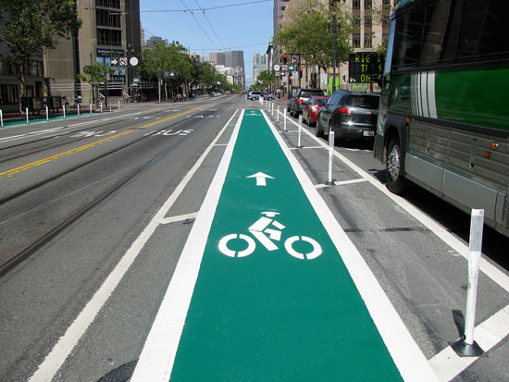
Transportation Impacts of Transit and Active Transport Projects
Old: Transit, active transportation projects slow automobile traffic, trigger LOS “impact to transportation”
New: Transit, active transportation presumed to reduce VMT unless demonstrated otherwise
Proposed Section 15064.3(b)(2)

Slide 25
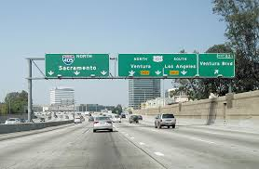
Transportation Impacts of Roadway Expansion Projects
Old: LOS impacts at nearby intersections from rerouted/induced vehicle travel
(Also: Induced VMT analysis required for GHG calculation)
New: Induced (or reduced) VMT
Proposed Section 15064.3(b)(2)

Slide 26
Safety
Potential safety issues
Increase exposure of cyclists and pedestrians (e.g. remove facilities, increase crossing distances)
Queues extending into the mainline
Speed differentials (<15 mph)
Increased motor vehicle speeds
Increased distance between bike or ped crossings
Proposed Section 15064.3(b)(3)

Slide 27
Methodology
Deference to lead agencies
Rule of reason
May use models to estimate
May revise inputs/outputs to reflect professional judgment (explain assumptions)
Proposed Section 15064.3(b)(4)

Slide 28
Mitigation and Alternatives
Examples proposed App F
Retains discretion for lead agencies
Cities and Counties can still apply their general plan and zoning codes
Examples drawn from CAPCOA (peer-reviewed, quantifiable)
Previously adopted measures
Proposed Section 15064.3(c), Proposed additions to Appendix F

Slide 29
Applicability
Phased approach to implementation
Guidelines apply prospectively only
Upon adoption, apply immediately within TPAs and HQTCs
Agencies can opt-in outside of those areas
Apply statewide after January 1, 2016
Proposed Section 15064.3(d)

Slide 30
Models and Technical Considerations in Assessing Vehicle Miles Traveled

Slide 31
Tools and Methods: Modeling VMT
Sketch models
For land use projects & land use plans
Approximately two dozen currently available, some free and downloadable
Rapid improvement
Travel demand models
For transportation projects & land use projects
Recent state investment
Both used for GHG analyses for several years

Slide 32
Tools and Methods: Counting VMT
Trip-based calculation
Residential: VMT/capita
Office: VMT/employee
Commercial or other: VMT/trip
Alternative: VMT/person-trip
Area-wide calculation
Change in VMT over the entire area

Slide 33
Methods for Counting VMT
CEQA Rule of Reason requires capturing spillover VMT

Slide 34
Estimating VMT from Roadway Capacity Increasing Projects

Slide 35
Roadway expansion projects typically increase VMT
Causes
Empirical study
Estimating VMT increase

Slide 36
Causes
Roadway expansion reduces travel time, which leads to:
Longer trips
Mode shift toward automobile
Newly generated trips
Route changes (can ↑ or ↓ or VMT)
More disperse land use development

Slide 37
1. Longer Trips (short-term)
Original VMT

Slide 38
1. Longer Trips (short-term)
Added Capacity
Original VMT

Slide 39
1. Longer Trips (short-term)
Added Capacity
Original VMT
Additional VMT

Slide 40
1. Longer Trips (mid-term)

Slide 41
1. Longer Trips (mid-term)

Slide 42
2. Mode Shift

Slide 43
2. Mode Shift

Slide 44
3. Newly Generated Trips

Slide 45
3. Newly Generated Trips

Slide 46
4. Route Changes

Slide 47
4. Route Changes

Slide 48
5. Disperse Land Use

Slide 49
5. Disperse Land Use

Slide 50
5. Disperse Land Use

Slide 51
Empirical Study
30+ studies on induced vehicle travel
Long-run elasticities typically 0.6 to 1.0
Recent ARB assessment
Policy Brief
http://www.arb.ca.gov/cc/sb375/policies/hwycapacity/highway_capacity_brief-4-21-14.pdf
Background Technical Document
http://www.arb.ca.gov/cc/sb375/policies/hwycapacity/highway_capacity_bkgd-4-21-14.pdf
VMT effects extend beyond project

Slide 52
Empirical Study
Source: Fehr and Peers

Slide 53
Estimation
A travel demand model can estimate:
Longer trips
Mode shift toward automobile
Newly generated trips [in some cases]
Route changes
But not:
Land use changes

Slide 54
Estimation
Options for estimating land use changes:
Employ a land use model
Employ an expert panel, e.g. using Delphi method
Examine gap between modeled and typical empirical results; adjust and/or explain model results

Slide 55
Implementation/Logistics
This is a preliminary discussion draft
Share widely – input wanted - help with outreach appreciated
Comment period through October 10
OPR incorporates comments, submits to Resources Agency
VMT goes live after formal rulemaking process
Applies prospectively, not to in progress EIRs
Initial application in TPAs, opt in elsewhere
Statewide requirement January 1, 2016

Slide 56
Thanks!
Chris Ganson
chris.ganson@opr.ca.gov

Slide 57
Extra Slides

Slide 58
VMT Mitigation Examples

Slide 59
Land Use and Location
Increase densities
Increase location efficiency and destination accessibility
Increase diversity of development (mix uses)
Integrate affordable housing
Improve development design and connectivity
Locate close to existing bus or rail stations
Photo credit: Currey, G. (2013). Paseo de San Antonio II, San Jose [photograph].
Notes:
This could be a good slide for a fruitvale photo

Slide 60
Destination Facilities
Travel Demand Management programs:
Ride-sharing, car-sharing, and bike-sharing
Subsidize or discount transit program
Encourage telecommuting and condensed work weeks
Sponsor vanpool/shuttle
Price workplace parking, or offer employee cash-outs
Bike storage
Locate employment centers and destinations close to transit or improve transit access
Photo credit: (2013). Bay Area Bike Share is now in San Francisco [photograph]. San Francisco Municipal Transportation Authority.
Notes:
Background image could be of bike infrastructure? Or business park?

Slide 61
Transit System Improvements
Fund or operate local shuttles
Improve transit system infrastructure:
Station enhancements, such as real-time information and improved waiting areas
Bike/ped access improvements, including bike storage and pedestrian paths
Park-and-ride lots
Fund new transit infrastructure
Contribute to the construction of a BRT or rail line
Photo credit: Ginty, C. (2006). LA metro liner with bicycle rack [photograph]. en.wikipedia.

Slide 62
Rural-Specific
Decrease lot sizes/increase densities within town centers
Add/improve sidewalks, bicycle lanes and racks
Orient buildings toward street
Mix uses
Operate and subsidize vanpools and on-demand shuttles
Photo credit: Crumm, I. (2007). GrassValleyCAHotel [photograph]. en.wikipedia.
Notes:
1. 10-20 acres per unit. This prevents too much growth from occurring in rural areas, channeling it all toward areas that have the accessibility and transit supply to absorb more population

Slide 63
Edge- and Suburb-Specific
Cluster new developments compactly
Provide sidewalk treatments that facilitate active mode transportation:
High quality crosswalks
Bulb outs and pedestrian refuge islands
Bike lanes and protected cycle tracks
Charge market rate for parking
Require larger employers to offer bike lockers, changing areas, and showers on-site
Encourage telecommuting
Photo credit: (2009). Old Town Pasadena [photograph]. LA Property Solutions.

Slide 64
Vehicle-Miles Traveled Impacts on the Environment, Human Health, and Fiscal Health

Slide 65
E N V I R O N M E N T
Transportation tailpipe emissions produce 36.5% of California greenhouse gas emissions
Carbon dioxide, methane, and nitrogen dioxide emissions all increase with VMT
400 million tons of asphalt is produced in the US for roads
Manufacture of each ton produces 570lbs of CO₂
Other car automobile emissions (CO, NO_{x}, PM_{2.5}, and ROC) cause damage to human health and agriculture CO₂
Photo credit: Morris, D.P. (2008) Exhaust billows out of a car tailpipe January 2, 2008 in San Francisco, California [Photograph]. Getty Images.

Slide 66
P U B L I C H E A L T H
1.1 deaths and 75 injuries per million vehicle miles traveled in the US (2011)
As VMT rises, physical activity decreases, and obesity, cardiovascular disease, and rates increase
Neighborhoods built to generate lower VMT tend to encourage active transportation by design
Longer commutes are associated with poor physical and mental health
High VMT-type neighborhoods are also associated with poor physical and mental health
Photo credit: Mcnew, D. (2006) The downtown skyline is enveloped in smog shortly before sunset on Nov. 17, 2006 in Los Angeles, California [Photograph]. Getty Images.
Notes:
4. Increased blood pressure and heart rate, negative mood, poor concentration levels, and aggression
5. social isolation, anxiety, increased blood pressure, headaches, stress, and depression

Slide 67
E N E R G Y
More disperse, high-VMT areas tend to use more energy for heating and cooling.
Typically, a large lot single family home in California uses nearly 3 times as much as a multifamily home
HOUSING TYPE | ANNUAL ENERGY CONSUMPTION (2005)
Large lot single family | 100 million Btu
Small lot single family | 71 million Btu
Attached single family | 54 million Btu
Multifamily | 38 million Btu
Photo credit: Rupert, N. (2008). Chicago Suburbs at night [Photograph].

Slide 68
W A T E R
High VMT-type developments use more water, mostly due to outdoor use
Typically, a large lot single family home in California uses twice as much as a multifamily home
Higher VMT means more runoff.
HOUSING TYPE | ANNUAL WATER CONSUMPTION (2005)
Large lot single family | 194,000 gal
Small lot single family | 125,000 gal
Attached single family | 93,000 gal
Multifamily | 89,000 gal
Notes:
Also in water loss during transport (from pipe leaks)
3. Because more roads need to be built, thus increasing impervious surface land cover. Increasing residential densities from 1 to 8 units can decrease surface runoff by up to 74%

Slide 69
A G R I C U L T U R E A N D O P E N S P A C E
Higher VMT developments tend to consume more land that would otherwise be used for agriculture
The most compact growth scenarios can save half of all agriculturally sensitive land, and all of wetland areas, while still accommodating the same amount of growth
Photo credit: Urban (2006). Californiacentralvalley [photograph]. en.wikipedia. Permission to reprint by en.wikipedia.
Notes:
Because they are more disperse, and occupy more land for the same amount of development (if a community is denser, it is absorbing development demand on a smaller footprint)
From a survey/study of Bay Area + Sacramento Area growth scenarios

Slide 70
I N C R E A S E D C O S T
T O L O C A L
G O V E R N M E N T
Higher VMT-type developments require higher road construction expenditures
Water and sewer infrastructure expenditures, as well as public service operating costs, reduce when development is more compact
Photo credit: Braut, S. (2008). Los Angeles urban sprawl [Photograph].
Notes:
less disperse developments tend to cost 75% compared to more disperse
Water and sewer reduced by 6.6% under compact scenarios. Compact growth scenarios could result in a compounding 2% annual budgetary savings for municipalities—up to $4 billion nationally between 2000 and 2025.

Slide 71
H O U S I N G S U P P L Y
A N D D E M A N D
M I S M A T C H
The four big California MPOs already suffer from an oversupply of traditional units
1/3 of American households want access to transit yet fewer than 10% have this
Younger generations are already showing a strong preference for Smart Growth communities
Already a near-term deficit in transit-oriented housing
California is not on the path to build enough transit-oriented housing
Photo credit: Laura Segall/Bloomberg via Getty Images.
Notes:
3 million in excess, as of 2012, according to
3. 61% of those born 1979-1996, versus 47% of those born 1934-1950
4. Housing stock increases annually only by 2%, so even if all new California residential units built in California were in transit station areas, the demand would still not be met by 2035
4. 2005-2025 there were 14.6 million households looking to locate within .5 miles of fixed-guideway transit, yet in 2005, there were only 6 million such houses available

